Slide 1
eMasters – Communication Systems E920 Wireless Communications
Notes, References, Questions, Problems, and Solutions
Venkateswar Reddy Melachervu
Jan 2023

Slide 2
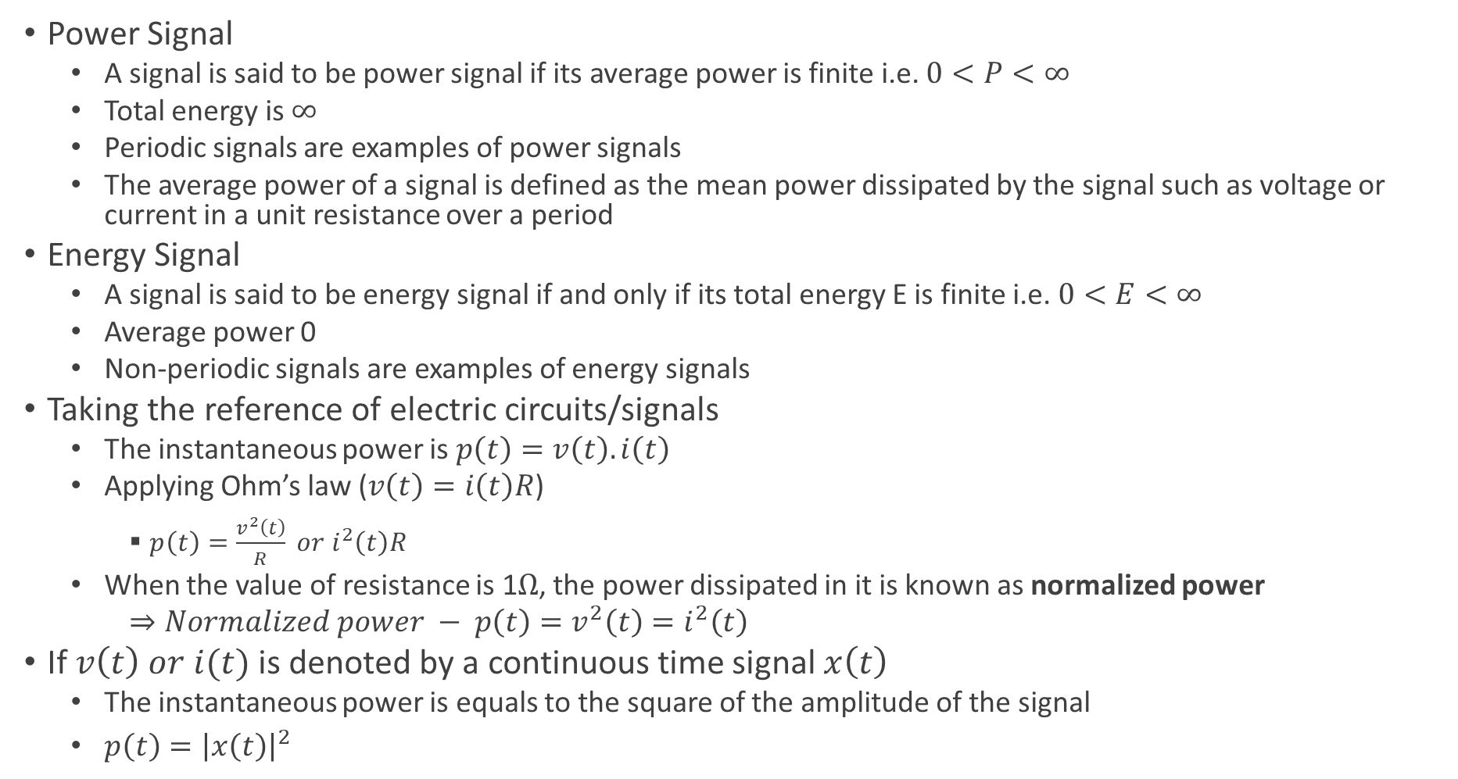
Key Concepts in Signal Processing
Power Signal
A signal is said to be power signal if its average power is finite i.e. $0<P<∞$
Total energy is $∞$
Periodic signals are examples of power signals
The average power of a signal is defined as the mean power dissipated by the signal such as voltage or current in a unit resistance over a period
Energy Signal
A signal is said to be energy signal if and only if its total energy E is finite i.e. $0<E<∞$
Average power 0
Non-periodic signals are examples of energy signals
Taking the reference of electric circuits/signals
The instantaneous power is $p\left(t\right)=v\left(t\right).i\left(t\right)$
Applying Ohm’s law ($v\left(t\right)=i\left(t\right)R$)
$p\left(t\right)=\frac{v^{2}\left(t\right)}{R} or i^{2}\left(t\right)R$
When the value of resistance is 1$Ω$, the power dissipated in it is known as normalized power
$⇒Normalized power − p\left(t\right)=v^{2}\left(t\right)=i^{2}\left(t\right)$
If $v\left(t\right) or i(t)$ is denoted by a continuous time signal $x\left(t\right)$
The instantaneous power is equals to the square of the amplitude of the signal
$p\left(t\right)={\left|x\left(t\right)\right|}^{2}$

Slide 3
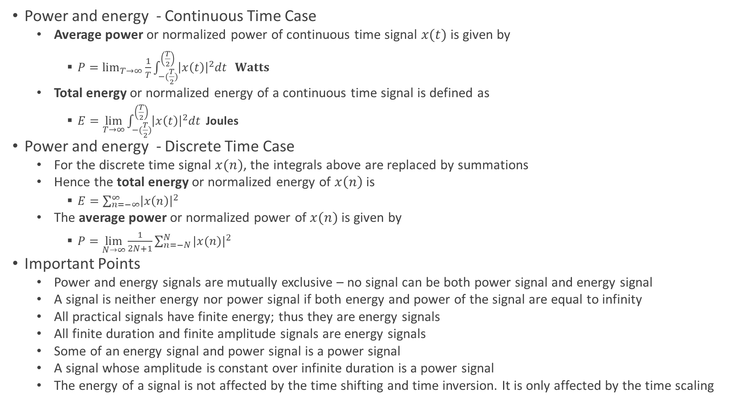
Key Concepts in Signal Processing
Power and energy - Continuous Time Case
Average power or normalized power of continuous time signal $x(t)$ is given by
$P=\lim_{T→∞}{\frac{1}{T}\int_{−(\frac{T}{2})}^{\left(\frac{T}{2}\right)}{{\left|x\left(t\right)\right|}^{2}dt} } Watts$
Total energy or normalized energy of a continuous time signal is defined as
$E=\lim_{T→∞}{\int_{−(\frac{T}{2})}^{\left(\frac{T}{2}\right)}{{\left|x\left(t\right)\right|}^{2}dt} }$Joules
Power and energy - Discrete Time Case
For the discrete time signal $x(n)$, the integrals above are replaced by summations
Hence the total energy or normalized energy of $x\left(n\right)$ is
$E=\sum_{n=−∞}^{∞}{{\left|x\left(n\right)\right|}^{2}}$
The average power or normalized power of $x(n)$ is given by
$P=\lim_{N→∞}{\frac{1}{2N+1}\sum_{n=−N}^{N}{{|x(n)|}^{2}}}$
Important Points
Power and energy signals are mutually exclusive – no signal can be both power signal and energy signal
A signal is neither energy nor power signal if both energy and power of the signal are equal to infinity
All practical signals have finite energy; thus they are energy signals
All finite duration and finite amplitude signals are energy signals
Some of an energy signal and power signal is a power signal
A signal whose amplitude is constant over infinite duration is a power signal
The energy of a signal is not affected by the time shifting and time inversion. It is only affected by the time scaling

Slide 4
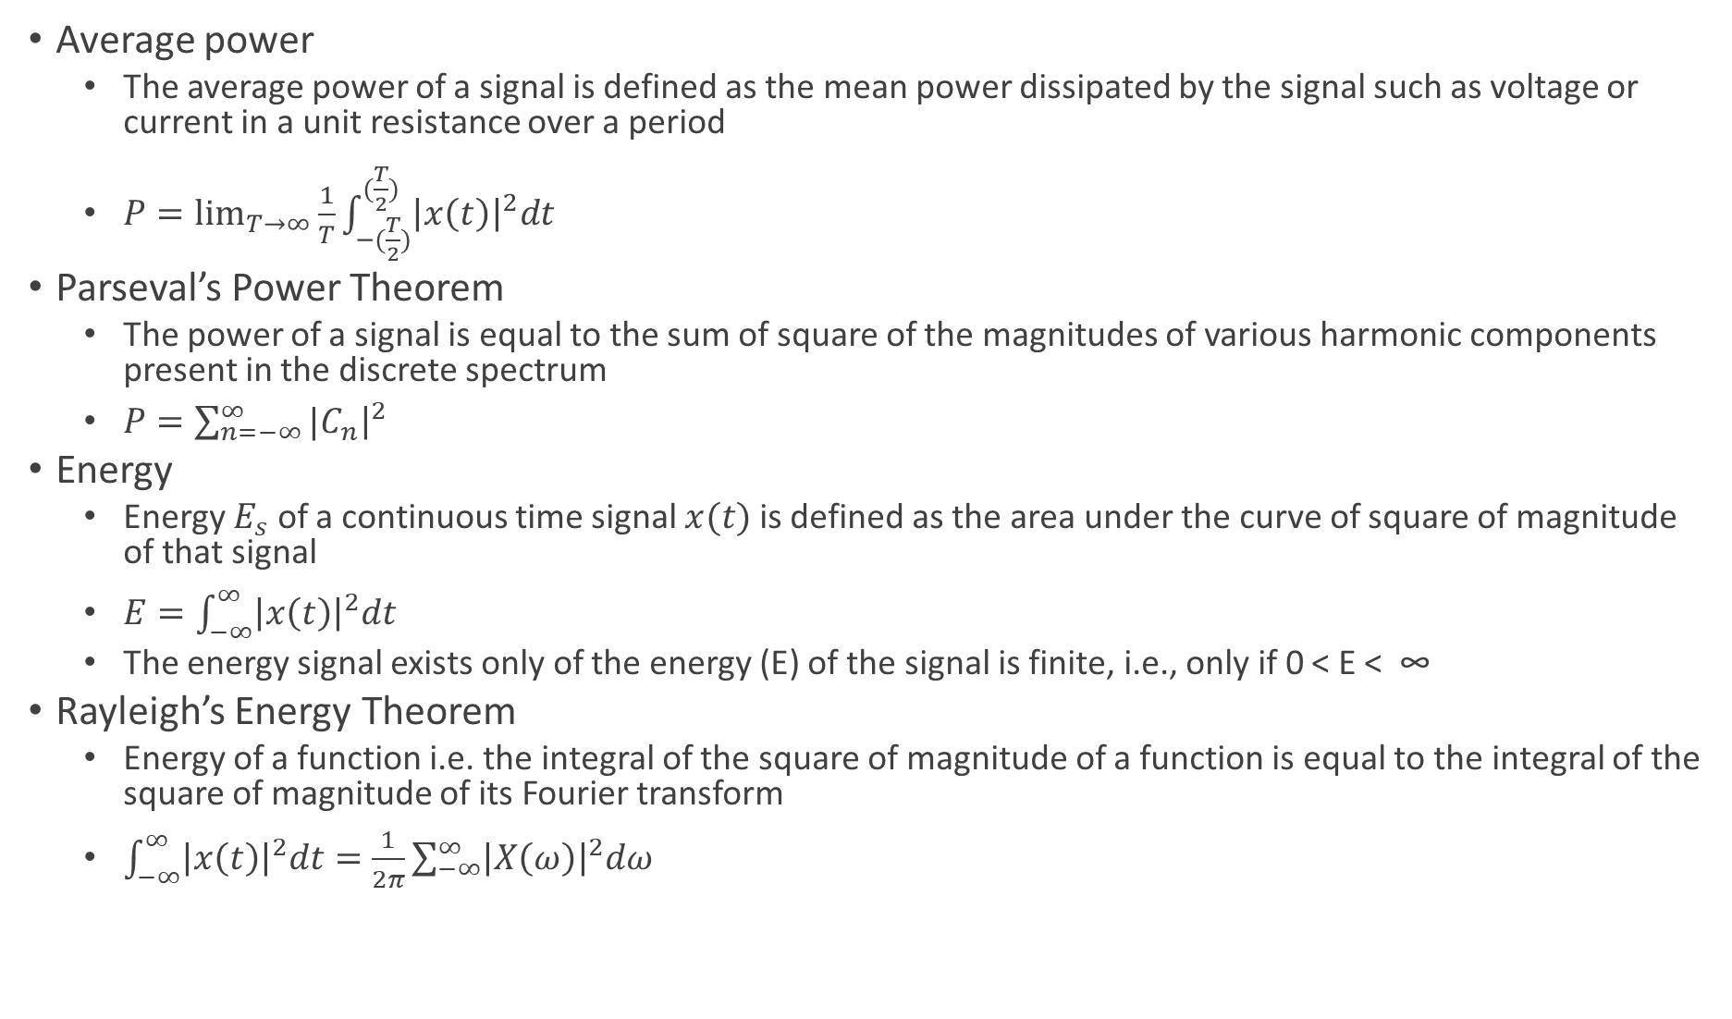
Key Concepts in Signal Processing
Average power
The average power of a signal is defined as the mean power dissipated by the signal such as voltage or current in a unit resistance over a period
$P=\lim_{T→∞}{\frac{1}{T}\int_{−(\frac{T}{2})}^{(\frac{T}{2})}{{\left|x\left(t\right)\right|}^{2}dt}}$
Parseval’s Power Theorem
The power of a signal is equal to the sum of square of the magnitudes of various harmonic components present in the discrete spectrum
$P=\sum_{n=−∞}^{∞}{{|C}_{n}{\left.​\right|}^{2}}$
Energy
Energy $E_{s}$ of a continuous time signal $x(t)$ is defined as the area under the curve of square of magnitude of that signal
$E=\int_{−∞}^{∞}{{\left|x\left(t\right)\right|}^{2}dt}$
The energy signal exists only of the energy (E) of the signal is finite, i.e., only if 0 < E < ∞
Rayleigh’s Energy Theorem
Energy of a function i.e. the integral of the square of magnitude of a function is equal to the integral of the square of magnitude of its Fourier transform
$\int_{−∞}^{∞}{{\left|x\left(t\right)\right|}^{2}dt=\frac{1}{2π}\sum_{−∞}^{∞}{{\left|X\left(ω\right)\right|}^{2}dω}}$

Slide 5
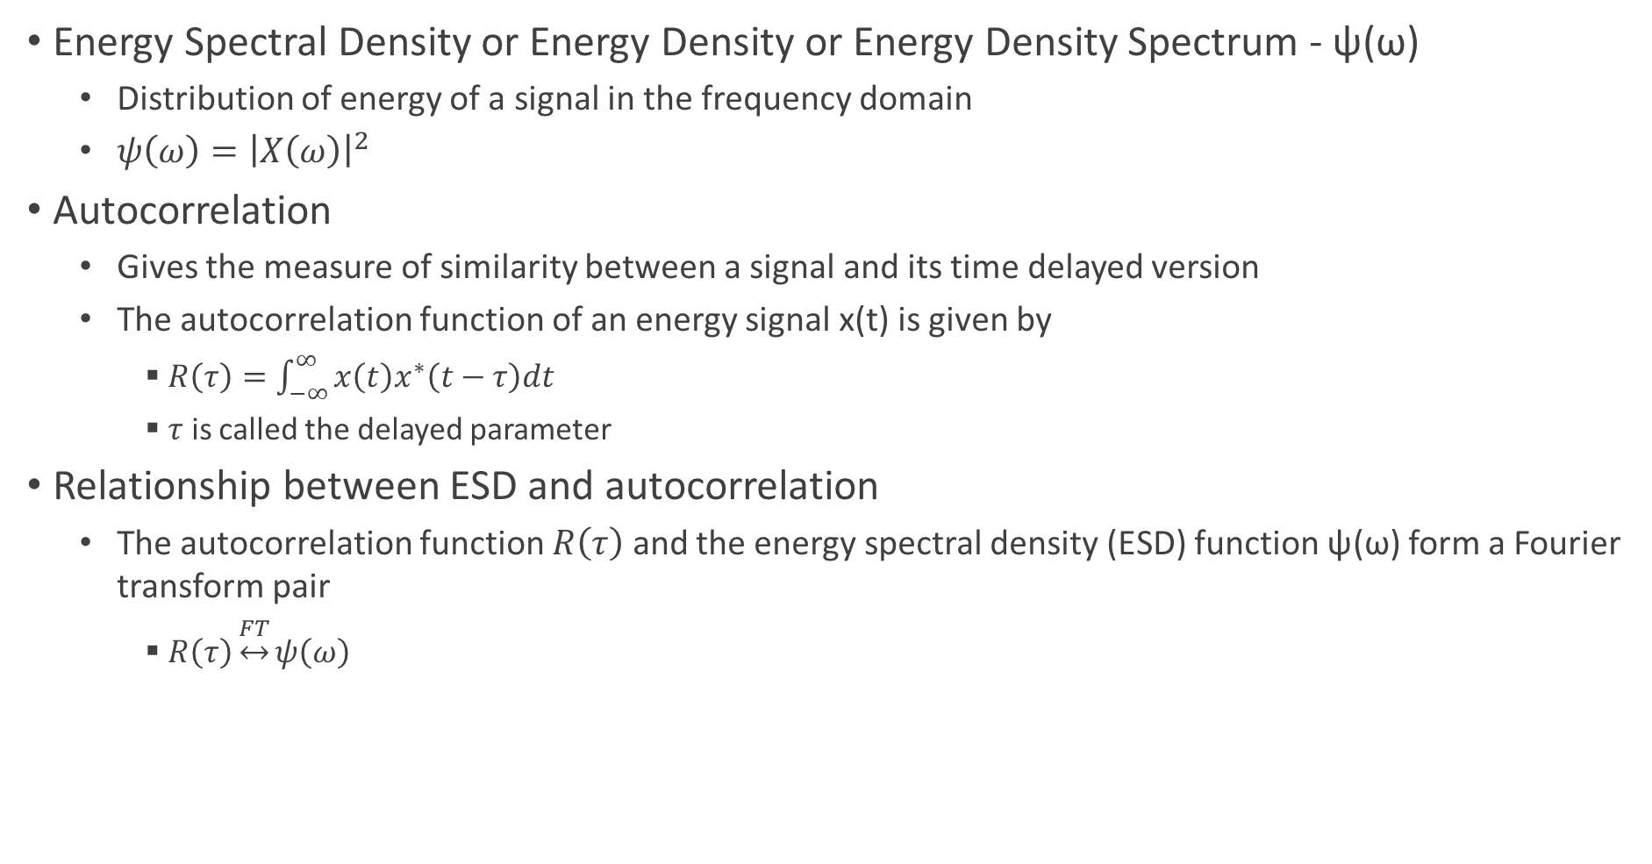
Energy Spectral Density and Autocorrelation
Energy Spectral Density or Energy Density or Energy Density Spectrum - ψ(ω)
Distribution of energy of a signal in the frequency domain
$ψ\left(ω\right)={\left|X\left(ω\right)\right|}^{2}$
Autocorrelation
Gives the measure of similarity between a signal and its time delayed version
The autocorrelation function of an energy signal x(t) is given by
$R\left(τ\right)=\int_{−∞}^{∞}{x\left(t\right)x^{∗}\left(t−τ\right)dt}$
$τ$ is called the delayed parameter
Relationship between ESD and autocorrelation
The autocorrelation function $R\left(τ\right)$ and the energy spectral density (ESD) function ψ(ω) form a Fourier transform pair
$R\left(τ\right)\underset{↔}{FT}ψ\left(ω\right)$

Slide 6
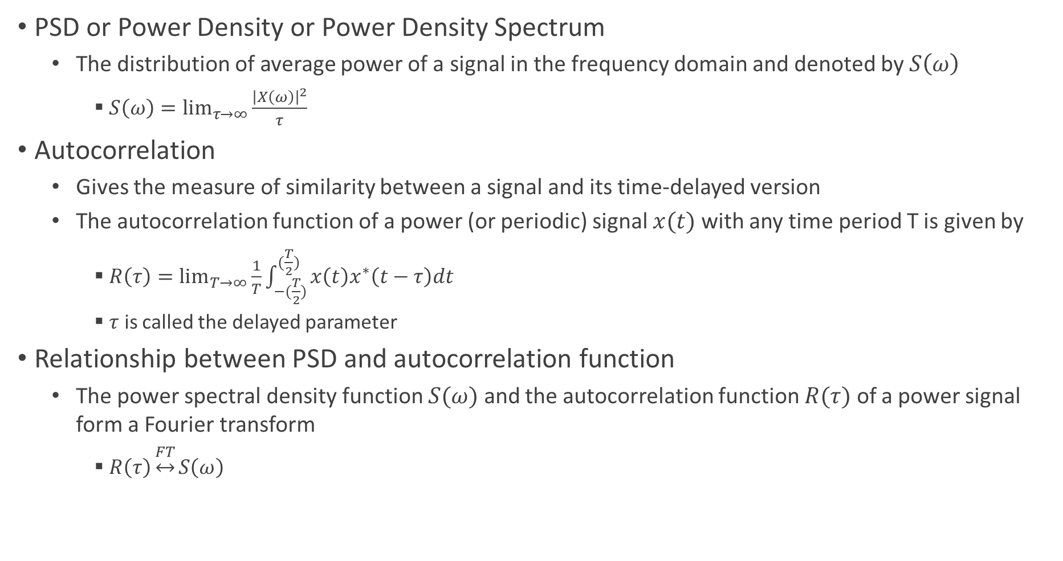
Power Spectral Density and Autocorrelation
PSD or Power Density or Power Density Spectrum
The distribution of average power of a signal in the frequency domain and denoted by $S\left(ω\right)$
$S\left(ω\right)=\lim_{τ→∞}{\frac{{\left|X\left(ω\right)\right|}^{2}}{τ}}$
Autocorrelation
Gives the measure of similarity between a signal and its time-delayed version
The autocorrelation function of a power (or periodic) signal $x(t)$ with any time period T is given by
$R\left(τ\right)=\lim_{T→∞}{\frac{1}{T}\int_{−(\frac{T}{2})}^{(\frac{T}{2})}{x\left(t\right)x^{∗}\left(t−τ\right)dt}}$
$τ$ is called the delayed parameter
Relationship between PSD and autocorrelation function
The power spectral density function $S(ω)$ and the autocorrelation function $R(τ)$ of a power signal form a Fourier transform
$R\left(τ\right)\underset{↔}{FT}S\left(ω\right)$

Slide 7
Modern Communication Technologies and Systems
Cutting edge wireless technologies
Multiple Antennae Systems
Multiple Input and Multiple Output - MIMO Technology
OFDM – Orthogonal Frequency Division Multiplexing
Large bandwidth divided into several sub-bands and multiple uses sub-carriers
CDMA
Spreading code
Modern cellular and wifi systems built on cutting edge wireless technologies
LTE
5G – NR
802.11 AC, 802.11 AX

Slide 8
Principles and Models of Modern Wireless Systems
Large Scale Fading
Due to path loss of signal as a function of distance and shadowing by large structures – buildings and hills
Occurs as mobile moves through a distance of the order of the cell size
Frequency independent
Small Scale Fading
Due to constructive and destructive interference of the multiple signal paths between the transmitter and receiver
Occurs at the spatial scale of the order of the carrier wavelength
Frequency dependent

Slide 9
Modern Communication Technologies and Systems
Cutting edge wireless technologies
Multiple Antennae Systems
Multiple Input and Multiple Output - MIMO Technology
OFDM – Orthogonal Frequency Division Multiplexing
Large bandwidth divided into several sub-bands and multiple uses sub-carriers
CDMA
Spreading code
Modern cellular and wifi systems built on cutting edge wireless technologies
LTE
5G – NR
802.11 AC, 802.11 AX

Slide 10
Modern Communication Technologies and Systems
Cutting edge wireless technologies
Multiple Antennae Systems
Multiple Input and Multiple Output - MIMO Technology
OFDM – Orthogonal Frequency Division Multiplexing
Large bandwidth divided into several sub-bands and multiple uses sub-carriers
CDMA
Spreading code
Modern cellular and wifi systems built on cutting edge wireless technologies
LTE
5G – NR
802.11 AC, 802.11 AX

Slide 11
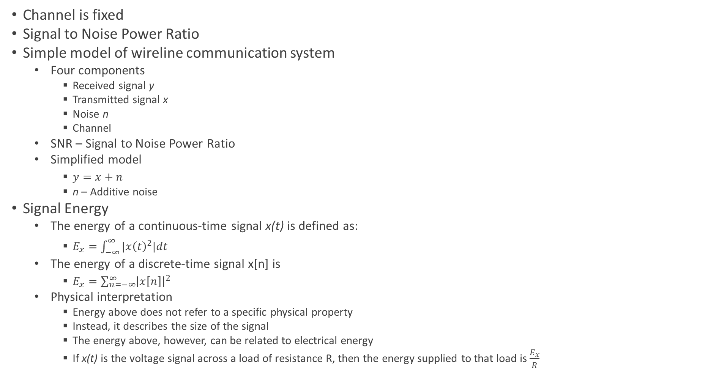
Modern Wireline Digital Communication System
Channel is fixed
Signal to Noise Power Ratio
Simple model of wireline communication system
Four components
Received signal y
Transmitted signal x
Noise n
Channel
SNR – Signal to Noise Power Ratio
Simplified model
$y=x+n$
n – Additive noise
Signal Energy
The energy of a continuous-time signal x(t) is defined as:
$E_{x}=\int_{−∞}^{∞}{|x{\left(t\right)}^{2}|dt}$
The energy of a discrete-time signal x[n] is
$E_{x}=\sum_{n=−∞}^{∞}{{\left|x\left[n\right]\right|}^{2}}$
Physical interpretation
Energy above does not refer to a specific physical property
Instead, it describes the size of the signal
The energy above, however, can be related to electrical energy
If x(t) is the voltage signal across a load of resistance R, then the energy supplied to that load is $\frac{E_{x}}{R}$

Slide 12
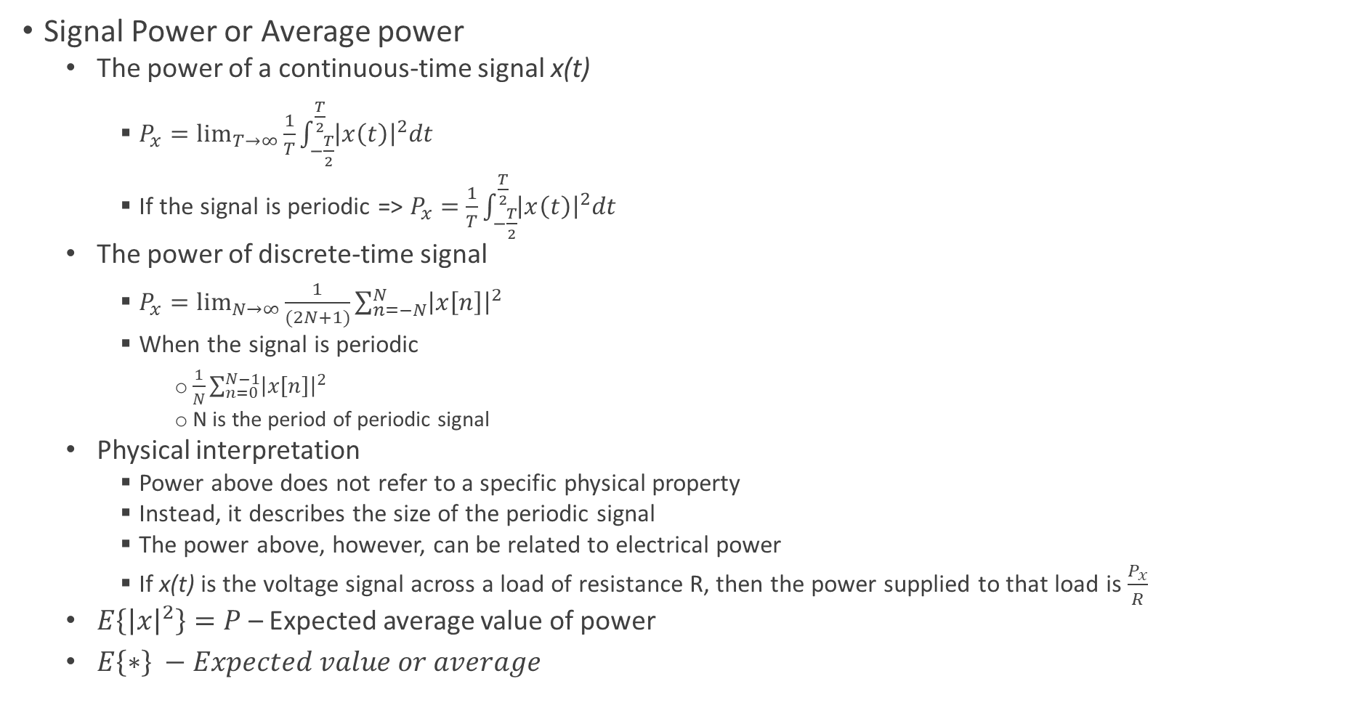
Modern Wireline Digital Communication System
Signal Power or Average power
The power of a continuous-time signal x(t)
$P_{x}=\lim_{T→∞}{\frac{1}{T}\int_{−\frac{T}{2}}^{\frac{T}{2}}{{\left|x\left(t\right)\right|}^{2}dt}}$
If the signal is periodic => $P_{x}=$ $\frac{1}{T}\int_{−\frac{T}{2}}^{\frac{T}{2}}{{\left|x\left(t\right)\right|}^{2}dt}$
The power of discrete-time signal
$P_{x}=\lim_{N→∞}{\frac{1}{(2N+1)}\sum_{n=−N}^{N}{{\left|x\left[n\right]\right|}^{2}}}$
When the signal is periodic
$\frac{1}{N}\sum_{n=0}^{N−1}{{\left|x\left[n\right]\right|}^{2}}$
N is the period of periodic signal
Physical interpretation
Power above does not refer to a specific physical property
Instead, it describes the size of the periodic signal
The power above, however, can be related to electrical power
If x(t) is the voltage signal across a load of resistance R, then the power supplied to that load is $\frac{P_{x}}{R}$
$E\left\{{\left|x\right|}^{2}\right\}=P$ – Expected average value of power
$E\left\{∗\right\} −Expected value or average$

Slide 13
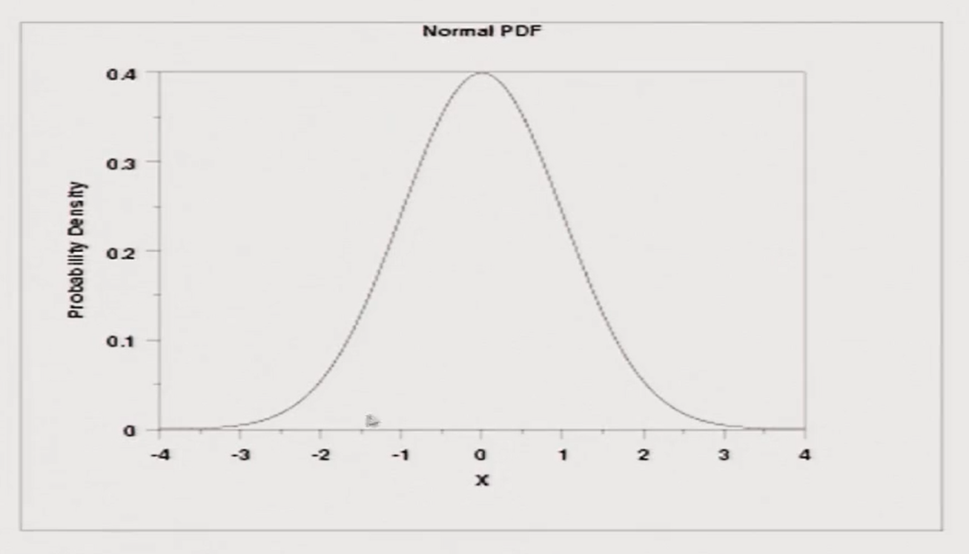
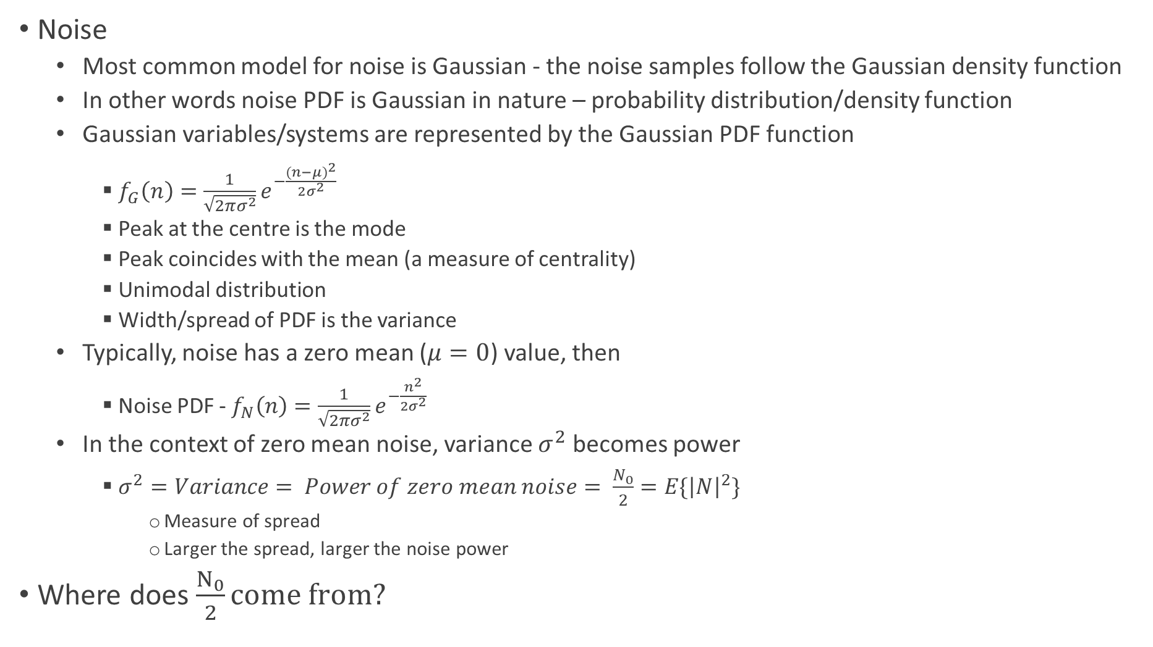
Additive White Gaussian Noise
Noise
Most common model for noise is Gaussian - the noise samples follow the Gaussian density function
In other words noise PDF is Gaussian in nature – probability distribution/density function
Gaussian variables/systems are represented by the Gaussian PDF function
$f_{G}\left(n\right)=\frac{1}{\sqrt{2πσ^{2}}}e^{−\frac{{(n−μ)}^{2}}{2σ^{2}}}$
Peak at the centre is the mode
Peak coincides with the mean (a measure of centrality)
Unimodal distribution
Width/spread of PDF is the variance
Typically, noise has a zero mean ($μ=0$) value, then
Noise PDF - $f_{N}\left(n\right)=\frac{1}{\sqrt{2πσ^{2}}}e^{−\frac{n^{2}}{2σ^{2}}}$
In the context of zero mean noise, variance $σ^{2}$ becomes power
$σ^{2}=Variance= Power of zero mean noise= \frac{N_{0}}{2}=E\{{\left|N\right|}^{2}\}$
Measure of spread
Larger the spread, larger the noise power
Where does $\frac{N_{0}}{2}come from?$

Slide 14
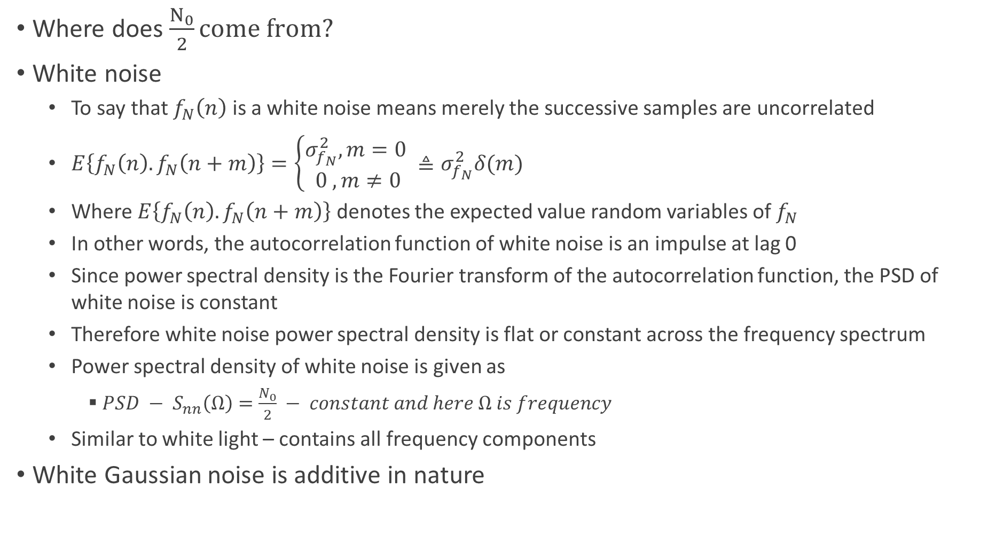
Additive White Gaussian Noise
Where does $\frac{N_{0}}{2}come from?$
White noise
To say that $f_{N}\left(n\right)$ is a white noise means merely the successive samples are uncorrelated
$E\left\{f_{N}\left(n\right).f_{N}\left(n+m\right)\right\}=\left\{\begin{aligned}σ_{f_{N}}^{2}, m=0 \\ 0 , m≠0\end{aligned}≜σ_{f_{N}}^{2}δ(m)\right.$
Where $E\left\{f_{N}\left(n\right).f_{N}\left(n+m\right)\right\}$ denotes the expected value random variables of $f_{N}$
In other words, the autocorrelation function of white noise is an impulse at lag 0
Since power spectral density is the Fourier transform of the autocorrelation function, the PSD of white noise is constant
Therefore white noise power spectral density is flat or constant across the frequency spectrum
Power spectral density of white noise is given as
$PSD − S_{nn}\left(Ω\right)=\frac{N_{0}}{2} − constant and here Ω is frequency$
Similar to white light – contains all frequency components
White Gaussian noise is additive in nature

Slide 15
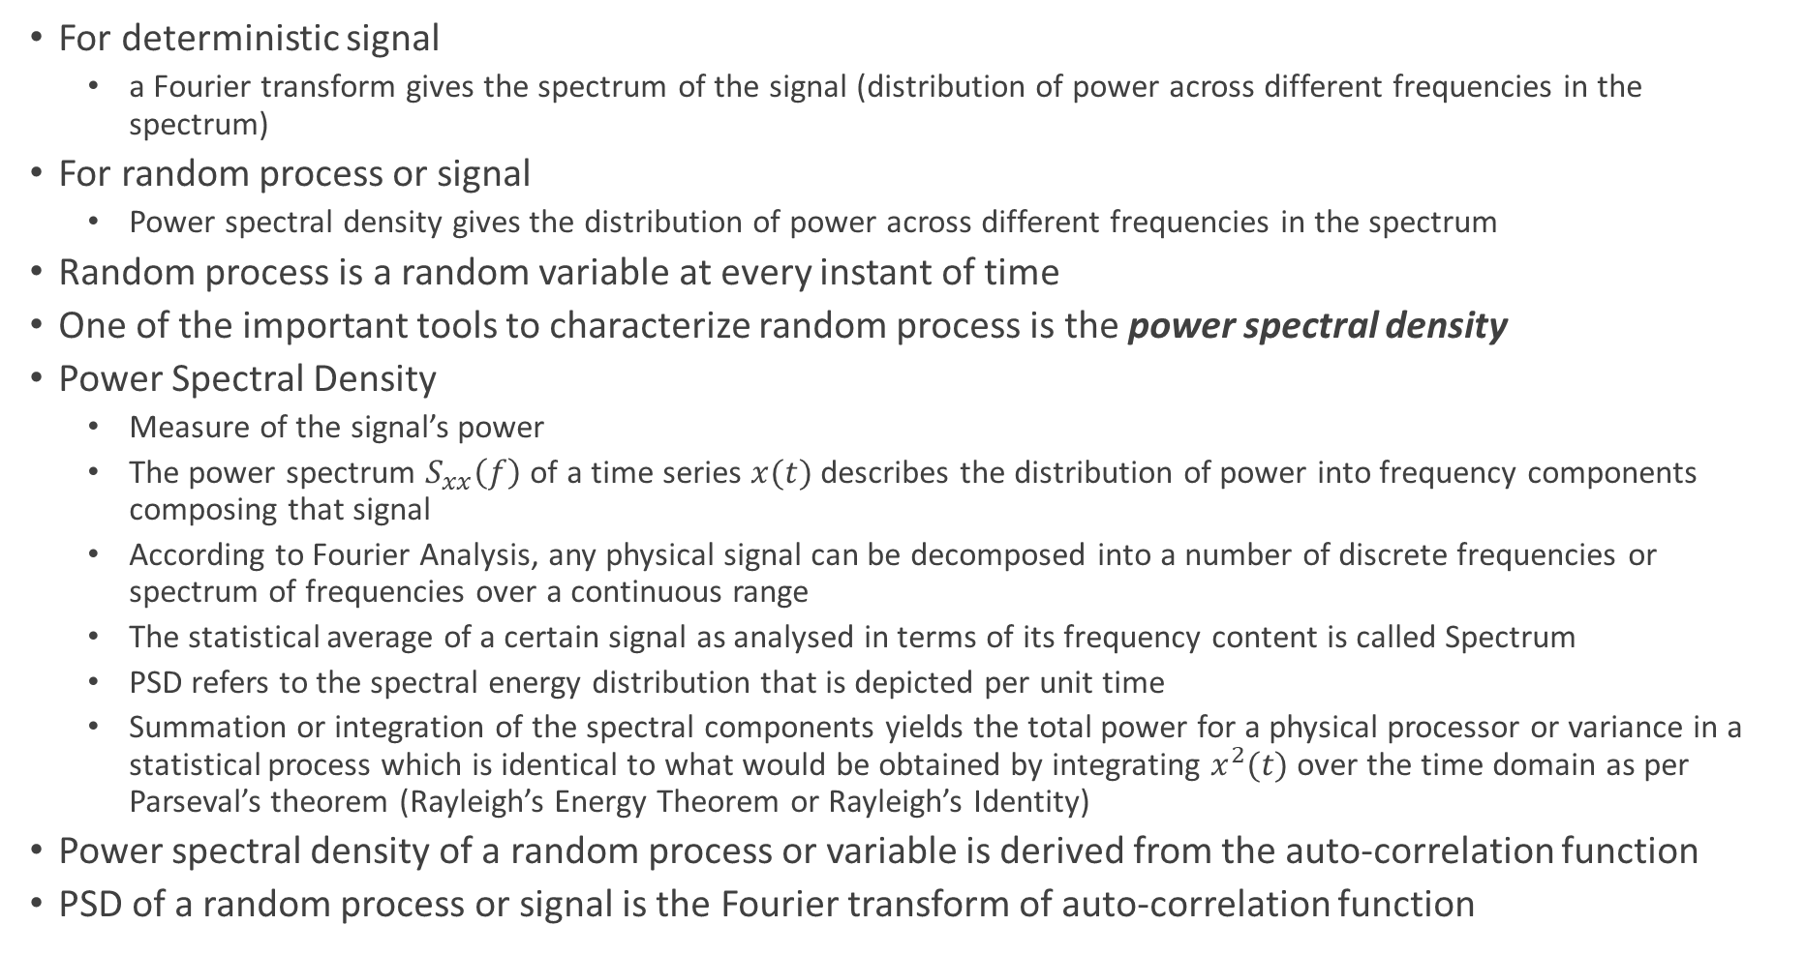
Random Process Characterization - Power Spectral Density
For deterministic signal
a Fourier transform gives the spectrum of the signal (distribution of power across different frequencies in the spectrum)
For random process or signal
Power spectral density gives the distribution of power across different frequencies in the spectrum
Random process is a random variable at every instant of time
One of the important tools to characterize random process is the power spectral density
Power Spectral Density
Measure of the signal’s power
The power spectrum $S_{xx}\left(f\right)$ of a time series $x(t)$ describes the distribution of power into frequency components composing that signal
According to Fourier Analysis, any physical signal can be decomposed into a number of discrete frequencies or spectrum of frequencies over a continuous range
The statistical average of a certain signal as analysed in terms of its frequency content is called Spectrum
PSD refers to the spectral energy distribution that is depicted per unit time
Summation or integration of the spectral components yields the total power for a physical processor or variance in a statistical process which is identical to what would be obtained by integrating $x^{2}(t)$ over the time domain as per Parseval’s theorem (Rayleigh’s Energy Theorem or Rayleigh’s Identity)
Power spectral density of a random process or variable is derived from the auto-correlation function
PSD of a random process or signal is the Fourier transform of auto-correlation function

Slide 16
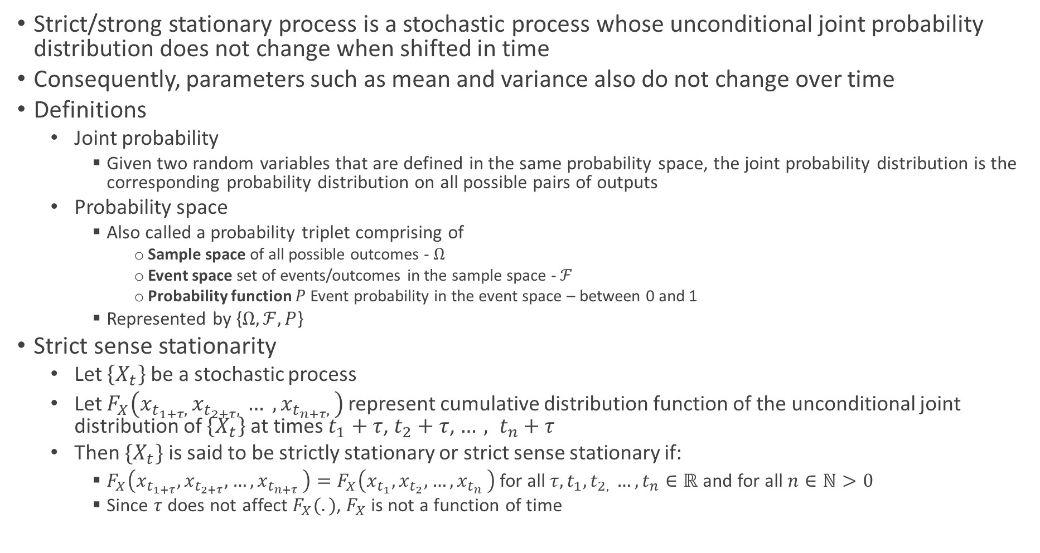
Stationary Process
Strict/strong stationary process is a stochastic process whose unconditional joint probability distribution does not change when shifted in time
Consequently, parameters such as mean and variance also do not change over time
Definitions
Joint probability
Given two random variables that are defined in the same probability space, the joint probability distribution is the corresponding probability distribution on all possible pairs of outputs
Probability space
Also called a probability triplet comprising of
Sample space of all possible outcomes - $Ω$
Event space set of events/outcomes in the sample space - $ℱ$
Probability function $P$Event probability in the event space – between 0 and 1
Represented by {$Ω, ℱ, P$}
Strict sense stationarity
Let $\left\{X_{t}\right\}$ be a stochastic process
Let $F_{X}\left(x_{t_{1+τ}, }x_{t_{2+τ}, }… , x_{t_{n+τ}, }\right)$represent cumulative distribution function of the unconditional joint distribution of $\left\{X_{t}\right\}$ at times $t_{1}+τ$, $t_{2}+τ$, ${…, t}_{n}+τ$
Then $\{X_{t}\}$ is said to be strictly stationary or strict sense stationary if:
$F_{X}\left(x_{t_{1+τ}}, x_{t_{2+τ}}, {…, x}_{t_{n+τ}}\right)=F_{X}\left(x_{t_{1}}, x_{t_{2}}, {…, x}_{t_{n}}\right)$ for all $τ, t_{1}, t_{2, }{…, t}_{n}∈ℝ$ and for all $n∈ℕ>0$
Since $τ$ does not affect $F_{X}(.)$, $F_{X}$ is not a function of time

Slide 17
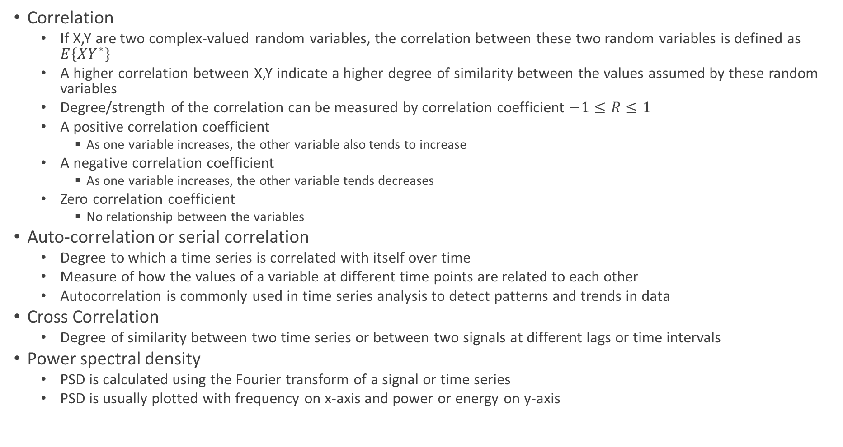
Auto-correlation, Cross Correlation and Power Spectral Density
Correlation
If X,Y are two complex-valued random variables, the correlation between these two random variables is defined as $E\{XY^{∗}\}$
A higher correlation between X,Y indicate a higher degree of similarity between the values assumed by these random variables
Degree/strength of the correlation can be measured by correlation coefficient $−1≤R≤1$
A positive correlation coefficient
As one variable increases, the other variable also tends to increase
A negative correlation coefficient
As one variable increases, the other variable tends decreases
Zero correlation coefficient
No relationship between the variables
Auto-correlation or serial correlation
Degree to which a time series is correlated with itself over time
Measure of how the values of a variable at different time points are related to each other
Autocorrelation is commonly used in time series analysis to detect patterns and trends in data
Cross Correlation
Degree of similarity between two time series or between two signals at different lags or time intervals
Power spectral density
PSD is calculated using the Fourier transform of a signal or time series
PSD is usually plotted with frequency on x-axis and power or energy on y-axis

Slide 18
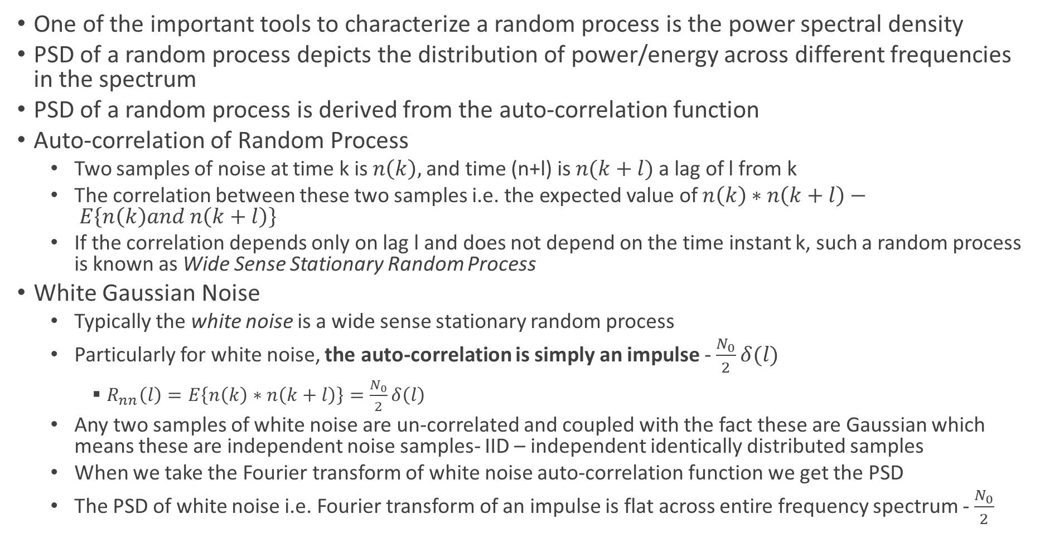
PSD of Random Process and White Noise
One of the important tools to characterize a random process is the power spectral density
PSD of a random process depicts the distribution of power/energy across different frequencies in the spectrum
PSD of a random process is derived from the auto-correlation function
Auto-correlation of Random Process
Two samples of noise at time k is $n\left(k\right),$and time (n+l) is $n(k+l)$ a lag of l from k
The correlation between these two samples i.e. the expected value of $n\left(k\right)∗n\left(k+l\right)− E\left\{n\left(k\right)and n\left(k+l\right)\right\}$
If the correlation depends only on lag l and does not depend on the time instant k, such a random process is known as Wide Sense Stationary Random Process
White Gaussian Noise
Typically the white noise is a wide sense stationary random process
Particularly for white noise, the auto-correlation is simply an impulse - $\frac{N_{0}}{2}δ(l)$
$R_{nn}\left(l\right)=E\left\{n\left(k\right)∗n\left(k+l\right)\right\}=\frac{N_{0}}{2}δ\left(l\right)$
Any two samples of white noise are un-correlated and coupled with the fact these are Gaussian which means these are independent noise samples- IID – independent identically distributed samples
When we take the Fourier transform of white noise auto-correlation function we get the PSD
The PSD of white noise i.e. Fourier transform of an impulse is flat across entire frequency spectrum - $\frac{N_{0}}{2}$

Slide 19
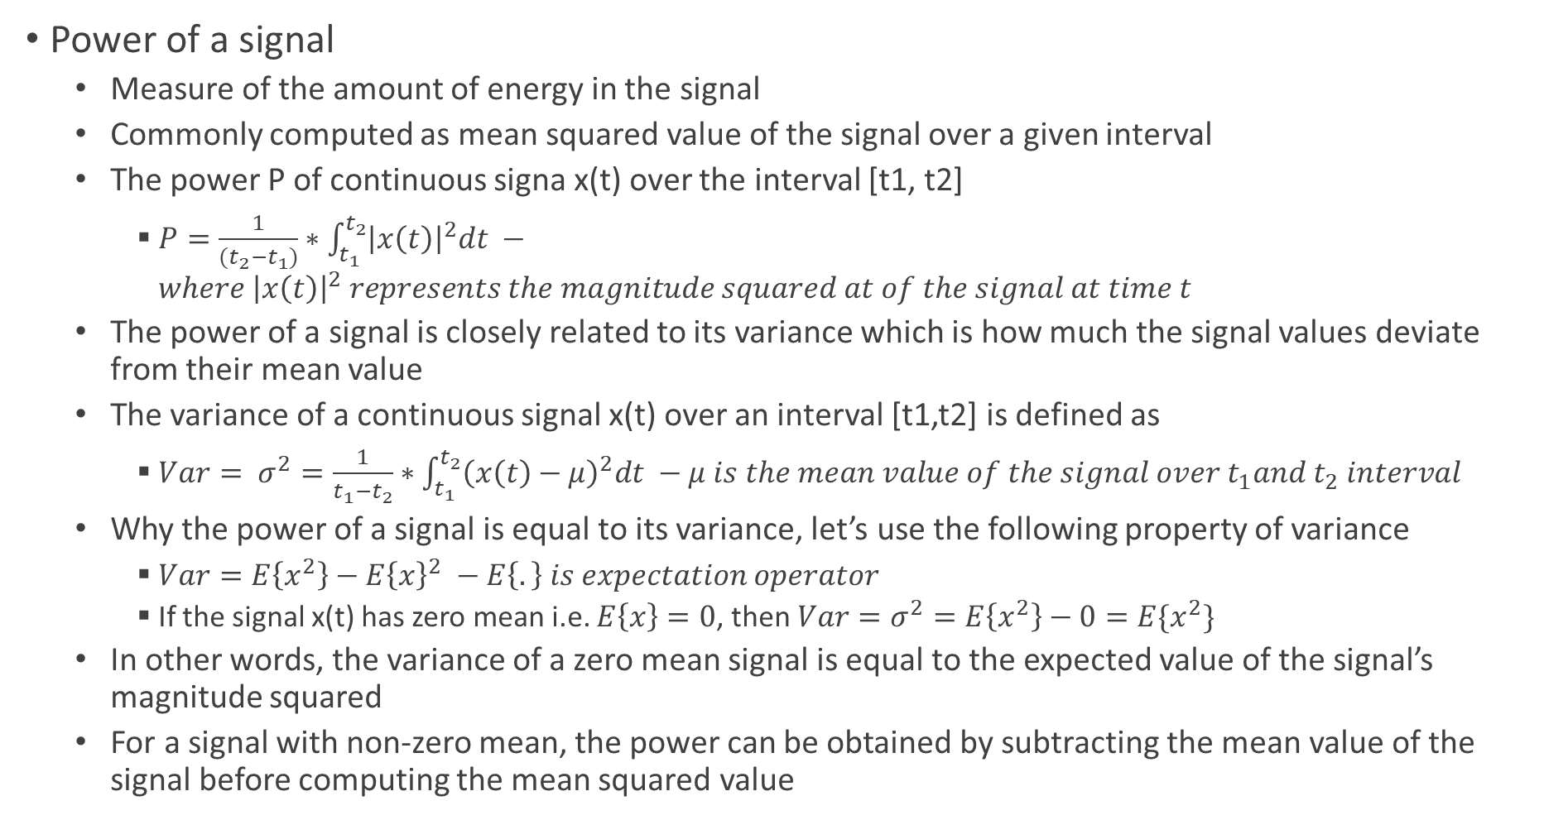
Notes – Power of a Signal and PSD of White Noise
Power of a signal
Measure of the amount of energy in the signal
Commonly computed as mean squared value of the signal over a given interval
The power P of continuous signa x(t) over the interval [t1, t2]
$P=\frac{1}{(t_{2}−t_{1})}∗\int_{t_{1}}^{t_{2}}{{\left|x\left(t\right)\right|}^{2}dt} −where {\left|x\left(t\right)\right|}^{2} represents the magnitude squared at of the signal at time t$
The power of a signal is closely related to its variance which is how much the signal values deviate from their mean value
The variance of a continuous signal x(t) over an interval [t1,t2] is defined as
$Var= σ^{2}=\frac{1}{t_{1}−t_{2}}∗\int_{t_{1}}^{t_{2}}{{\left(x\left(t\right)−μ\right)}^{2}dt} −μ is the mean value of the signal over t_{1}and t_{2} interval$
Why the power of a signal is equal to its variance, let’s use the following property of variance
$Var=E\left\{x^{2}\right\}−E{\left\{x\right\}}^{2} −E\left\{.\right\} is expectation operator$
If the signal x(t) has zero mean i.e. $E\left\{x\right\}=0$, then $Var=σ^{2}=E\left\{x^{2}\right\}−0=E\{x^{2}\}$
In other words, the variance of a zero mean signal is equal to the expected value of the signal’s magnitude squared
For a signal with non-zero mean, the power can be obtained by subtracting the mean value of the signal before computing the mean squared value

Slide 20

Wireline SNR – Signal to Noise Power Ratio
$y=x+n$
$SNR=\frac{E{\left|x\right|}^{2}}{E\left\{{\left|n\right|}^{2}\right\}}=\frac{P}{\frac{N_{0}}{2}}=\frac{2P}{N_{0}}$ ~$\frac{P}{N_{0}}\sim \frac{P}{σ^{2}}$ - P is the power of the signal
Approximately constant because channel is fixed
Hence no variations or fluctuations in SNR and hence performance is fixed

Slide 21
Performance of Communication System
BER is the probability that a single received bit is in error
Bit Error Rate is an important metric for communication system performance

Slide 22
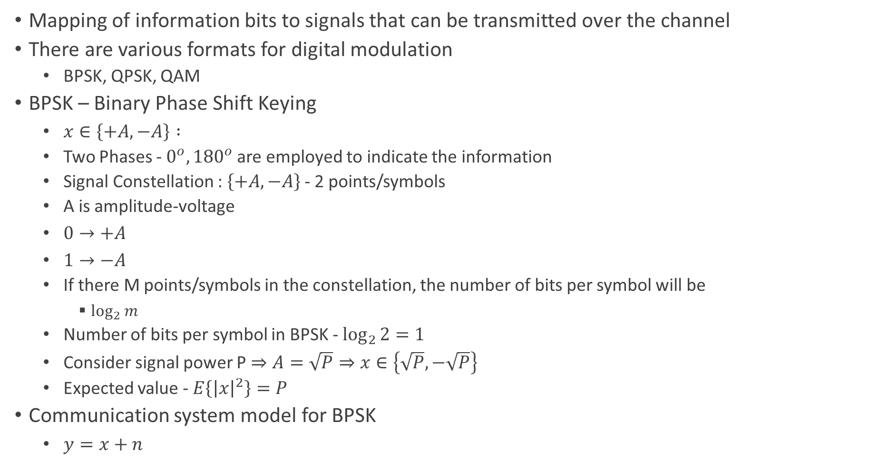
Digital Modulation - BPSK
Mapping of information bits to signals that can be transmitted over the channel
There are various formats for digital modulation
BPSK, QPSK, QAM
BPSK – Binary Phase Shift Keying
$x∈\left\{+A, −A\right\} :$
Two Phases - $0^{o}, {180}^{o}$are employed to indicate the information
Signal Constellation : $\left\{+A,−A\right\}$ - 2 points/symbols
A is amplitude-voltage
$0→+A$
$1→−A$
If there M points/symbols in the constellation, the number of bits per symbol will be
$\log_{2}{m}$
Number of bits per symbol in BPSK - $\log_{2}{2}=1$
Consider signal power P$⇒A=\sqrt{P}⇒x∈\left\{\sqrt{P},−\sqrt{P}\right\}$
Expected value - $E\left\{{\left|x\right|}^{2}\right\}=P$
Communication system model for BPSK
$y=x+n$

Slide 23
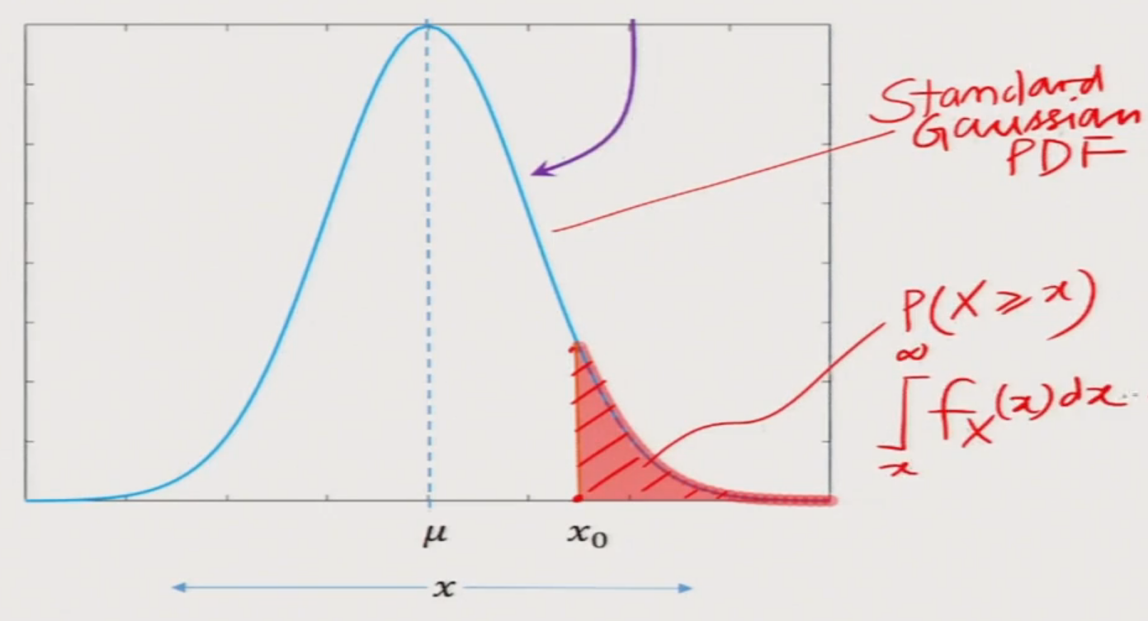
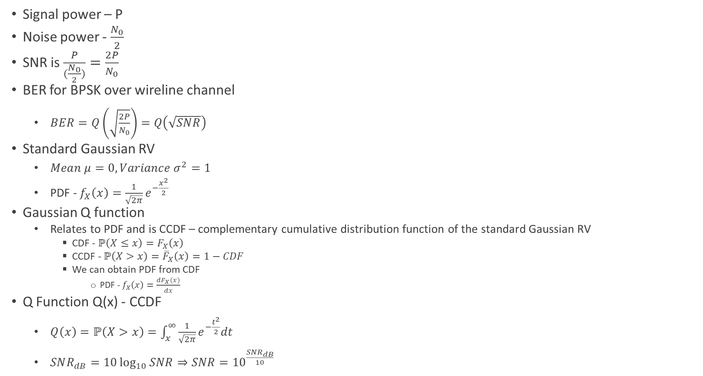
BPSK Wireline Performance
Signal power – P
Noise power - $\frac{N_{0}}{2}$
SNR is $\frac{P}{(\frac{N_{0}}{2})}=\frac{2P}{N_{0}}$
BER for BPSK over wireline channel
$BER=Q\left(\sqrt{\frac{2P}{N_{0}}}\right)=Q\left(\sqrt{SNR}\right)$
Standard Gaussian RV
$Mean μ=0, Variance σ^{2}=1$
PDF - $f_{X}\left(x\right)=\frac{1}{\sqrt{2π}}e^{−\frac{x^{2}}{2}}$
Gaussian Q function
Relates to PDF and is CCDF – complementary cumulative distribution function of the standard Gaussian RV
CDF - $ℙ\left(X≤x\right)=F_{X}\left(x\right)$
CCDF - $ℙ\left(X>x\right)={\overline{F}}_{X}\left(x\right)=1−CDF$
We can obtain PDF from CDF
PDF - $f_{X}\left(x\right)=\frac{dF_{X}(x)}{dx}$
Q Function Q(x) - CCDF
$Q\left(x\right)=ℙ\left(X>x\right)=\int_{x}^{∞}{\frac{1}{\sqrt{2π}}}e^{−\frac{t^{2}}{2}}dt$
$SNR_{dB}=10\log_{10}{SNR⇒SNR={10}^{\frac{SNR_{dB}}{10}}}$

Slide 24
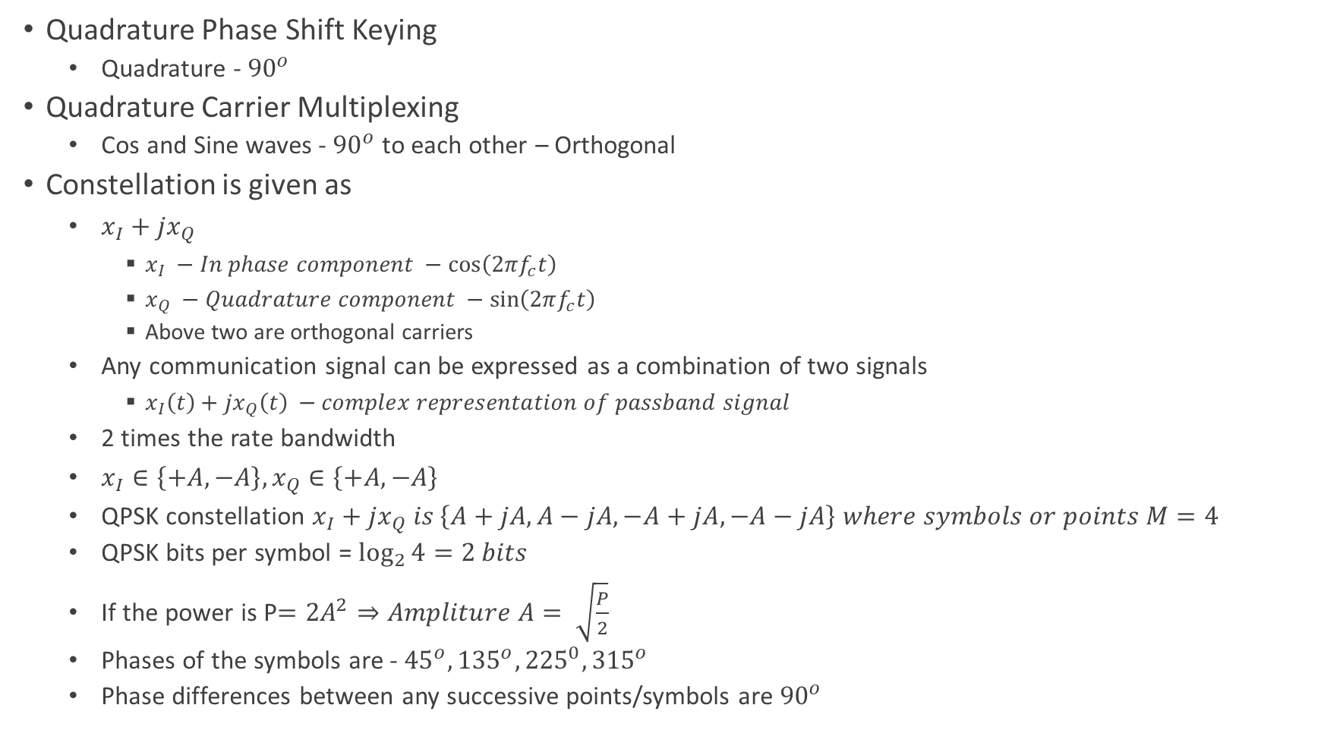
QPSK
Quadrature Phase Shift Keying
Quadrature - ${90}^{o}$
Quadrature Carrier Multiplexing
Cos and Sine waves - ${90}^{o}$ to each other – Orthogonal
Constellation is given as
$x_{I}+{jx}_{Q}$
$x_{I} −In phase component −\cos\left(2πf_{c}t\right)$
$x_{Q} −Quadrature component −\sin\left(2πf_{c}t\right)$
Above two are orthogonal carriers
Any communication signal can be expressed as a combination of two signals
$x_{I}\left(t\right)+{jx}_{Q}\left(t\right) −complex representation of passband signal$
2 times the rate bandwidth
$x_{I}∈\left\{+A, −A\right\}, x_{Q}∈\left\{+A,−A\right\}$
QPSK constellation $x_{I}+{jx}_{Q} is \left\{A+jA, A−jA, −A+jA, −A−jA\right\} where symbols or points M=4$
QPSK bits per symbol = $\log_{2}{4}=2 bits$
If the power is P$=2A^{2}⇒Ampliture A= \sqrt{\frac{P}{2}}$
Phases of the symbols are - ${45}^{o}, {135}^{o}, {225}^{0},{315}^{o}$
Phase differences between any successive points/symbols are ${90}^{o}$

Slide 25
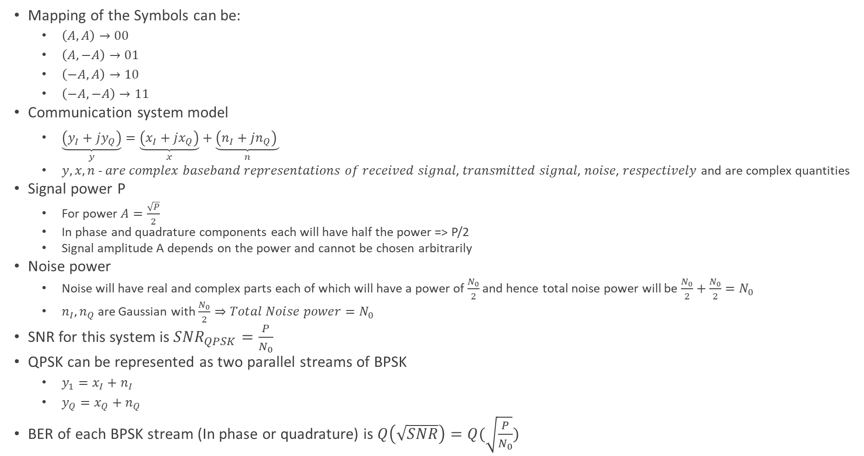
QPSK
Mapping of the Symbols can be:
$\left(A,A\right)→00$
$\left(A,−A\right)→01$
$\left(−A,A\right)→10$
$\left(−A,−A\right)→11$
Communication system model
$\underset{y}{\underbrace{\left(y_{I}+jy_{Q}\right)}}=\underset{x}{\underbrace{\left(x_{I}+jx_{Q}\right)}}+\underset{n}{\underbrace{\left(n_{I}+jn_{Q}\right) }}$
$y,x,n$- 𝑎𝑟𝑒 𝑐𝑜𝑚𝑝𝑙𝑒𝑥 𝑏𝑎𝑠𝑒𝑏𝑎𝑛𝑑 𝑟𝑒𝑝𝑟𝑒𝑠𝑒𝑛𝑡𝑎𝑡𝑖𝑜𝑛𝑠 𝑜𝑓 𝑟𝑒𝑐𝑒𝑖𝑣𝑒𝑑 𝑠𝑖𝑔𝑛𝑎𝑙, 𝑡𝑟𝑎𝑛𝑠𝑚𝑖𝑡𝑡𝑒𝑑 𝑠𝑖𝑔𝑛𝑎𝑙, 𝑛𝑜𝑖𝑠𝑒, 𝑟𝑒𝑠𝑝𝑒𝑐𝑡𝑖𝑣𝑒𝑙𝑦 and are complex quantities
Signal power P
For power $A=\frac{\sqrt{P}}{2}$
In phase and quadrature components each will have half the power => P/2
Signal amplitude A depends on the power and cannot be chosen arbitrarily
Noise power
Noise will have real and complex parts each of which will have a power of $\frac{N_{0}}{2}$ and hence total noise power will be $\frac{N_{0}}{2}+\frac{N_{0}}{2}=N_{0}$
$n_{I},n_{Q}$ are Gaussian with $\frac{N_{0}}{2}⇒Total Noise power=N_{0}$
SNR for this system is $SNR_{QPSK}=\frac{P}{N_{0}}$
QPSK can be represented as two parallel streams of BPSK
$y_{1}=x_{I}+n_{I}$
$y_{Q}=x_{Q}+n_{Q}$
BER of each BPSK stream (In phase or quadrature) is $Q\left(\sqrt{SNR}\right)=Q(\sqrt{\frac{P}{N_{0}}})$

Slide 26

QPSK
QPSK symbol is in error when either of the bits (in phase and quadrature) is in error
Symbol Error Rate of QPSK
$SER_{QPSK}=1−{\left(1−Q\left(\sqrt{SNR_{QPSK}}\right)\right)}^{2}$
$SER_{QPSK}$ $≈2∗BER_{BPSK}=2Q\left(\sqrt{SNR}\right)=2Q(\sqrt{\frac{P}{N_{0}}})$

Slide 27
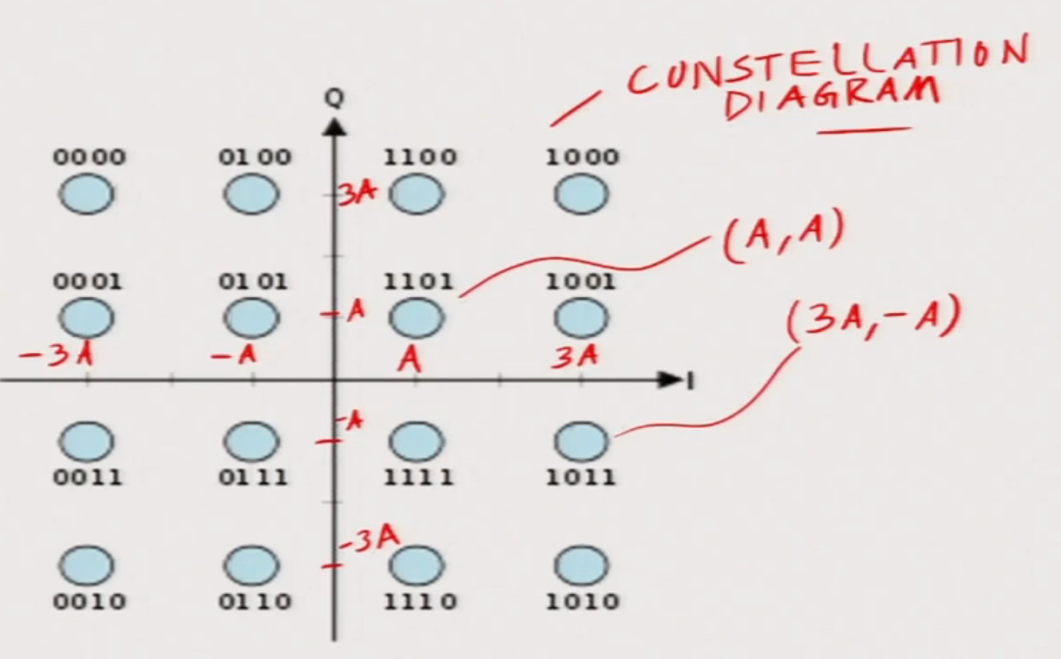
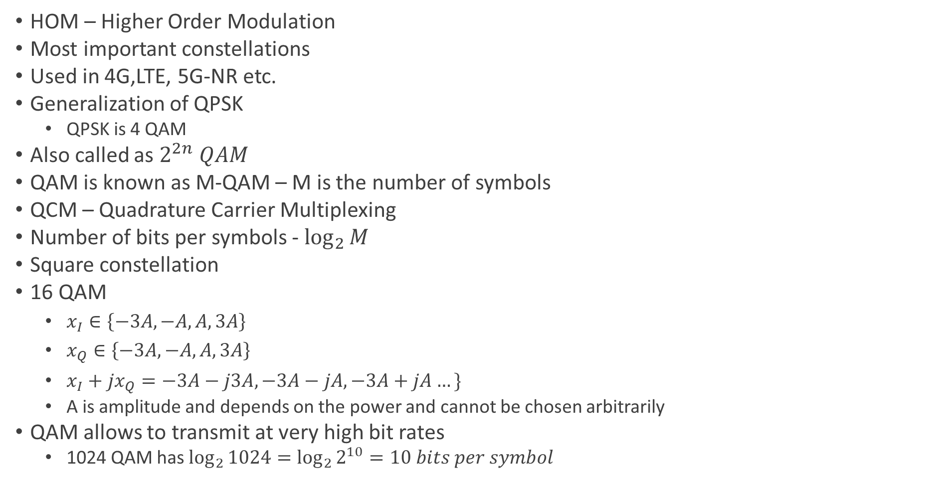
QAM – Quadrature Amplitude Modulation
HOM – Higher Order Modulation
Most important constellations
Used in 4G,LTE, 5G-NR etc.
Generalization of QPSK
QPSK is 4 QAM
Also called as $2^{2n} QAM$
QAM is known as M-QAM – M is the number of symbols
QCM – Quadrature Carrier Multiplexing
Number of bits per symbols - $\log_{2}{M}$
Square constellation
16 QAM
$x_{I}∈\left\{−3A, −A, A,3A\right\}$
$x_{Q}∈\left\{−3A, −A, A,3A\right\}$
$x_{I}+{jx}_{Q}=−3A−j3A,−3A−jA, −3A+jA…\}$
A is amplitude and depends on the power and cannot be chosen arbitrarily
QAM allows to transmit at very high bit rates
1024 QAM has $\log_{2}{1024=\log_{2}{2^{10}}=10 bits per symbol}$

Slide 28

QAM
AMC – Adaptive modulation and coding – is employed by mobile communication systems for effective communication
$Signal power − P=E\left\{{\left|x\right|}^{2}\right\}=E_{S}, Noise power − N_{0}=E{\left\{\left|n\right|\right\}}^{2}$
Symbol Error Rate for m-ary QAM is:
SER $≈4\left(1−\frac{1}{\sqrt{M}}\right)Q\left(\sqrt{\frac{3P}{N_{0}\left(M−1\right)}}\right) −M−modulation order$

Slide 29
Wireless Channel and Performance
Multiple propagation paths – LOS, and several NLOS – multipath propagation due to scatterers
Multipaths exists due to large objects or scatters
Multipath propagation leads to multiple copies of the signal at the receiver
Multiple signal copies causes superposition of the signals at the receiver resulting interference – constructive and destructive
Because of interference, the SNR varies or fluctuates
Due to interference, received signal power fluctuates or varies and this phenomenon is called fading
Wireless channel is also called fading channel - where the received power dips significantly is termed as deep fade

Slide 30

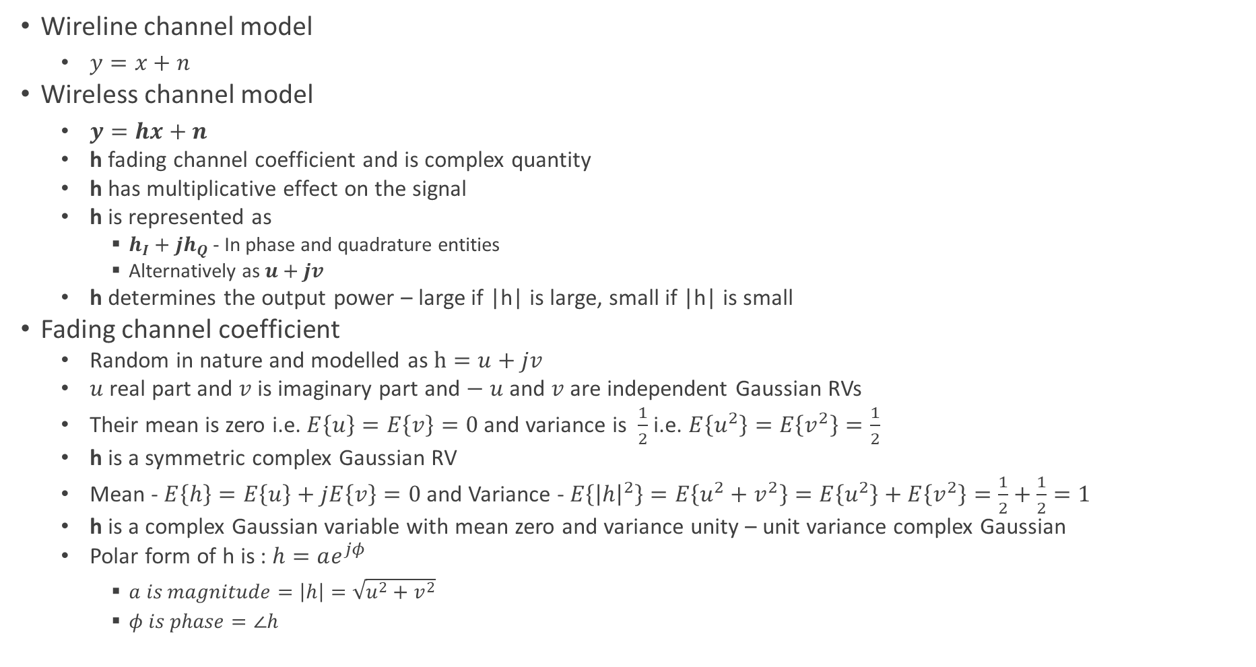


Wireless Channel Model
Wireline channel model
$y=x+n$
Wireless channel model
$y=hx+n$
h fading channel coefficient and is complex quantity
h has multiplicative effect on the signal
h is represented as
$h_{I}+jh_{Q}$ - In phase and quadrature entities
Alternatively as $u+jv$
h determines the output power – large if |h| is large, small if |h| is small
Fading channel coefficient
Random in nature and modelled as $h=u+jv$
$u$real part and $v$is imaginary part and $− u$ and $v$ are independent Gaussian RVs
Their mean is zero i.e. $E\left\{u\right\}=E\left\{v\right\}=0$ and variance is $\frac{1}{2}$ i.e. $E\left\{u^{2}\right\}=E\left\{v^{2}\right\}=\frac{1}{2}$
h is a symmetric complex Gaussian RV
Mean - $E\left\{h\right\}=E\left\{u\right\}+jE\left\{v\right\}=0$ and Variance - $E\left\{{\left|h\right|}^{2}\right\}=E\left\{u^{2}+v^{2}\right\}=E\left\{u^{2}\right\}+E\left\{v^{2}\right\}=\frac{1}{2}+\frac{1}{2}=1$
h is a complex Gaussian variable with mean zero and variance unity – unit variance complex Gaussian
Polar form of h is : $h=ae^{jφ}$
$a is magnitude=\left|h\right|=\sqrt{u^{2}+v^{2}}$
$φ is phase=∠h$
$$h$$
$$x$$
$$y=hx+n$$
$$n −Receiver thermal noise$$

Slide 31
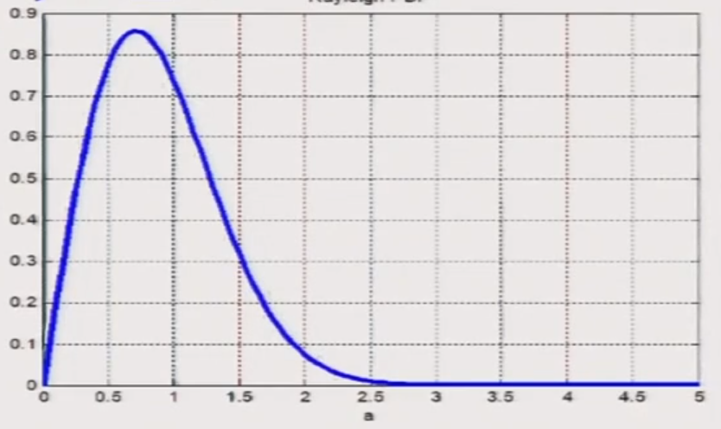

Fading Channel Coefficient
Amplitude
The channel coefficient h in the polar form is $ae^{jφ} −a is amplitude and φ is phase$
The amplitude a follows the Rayleigh PDF
$f_{A}\left(a\right)=\left\{\begin{aligned}2ae^{−a^{2}}, a≥0 \\ 0, a<0\end{aligned}\right.$
Rayleigh fading channel
Phase
$φ$ phase is uniformly distributed across $−π,π or 0,π$
PDF of phase = $f_{Φ}\left(φ\right)=\left\{\begin{aligned}\frac{1}{2π} , −π<φ≤π \\ 0, Otherwise\end{aligned}\right.$

Slide 32
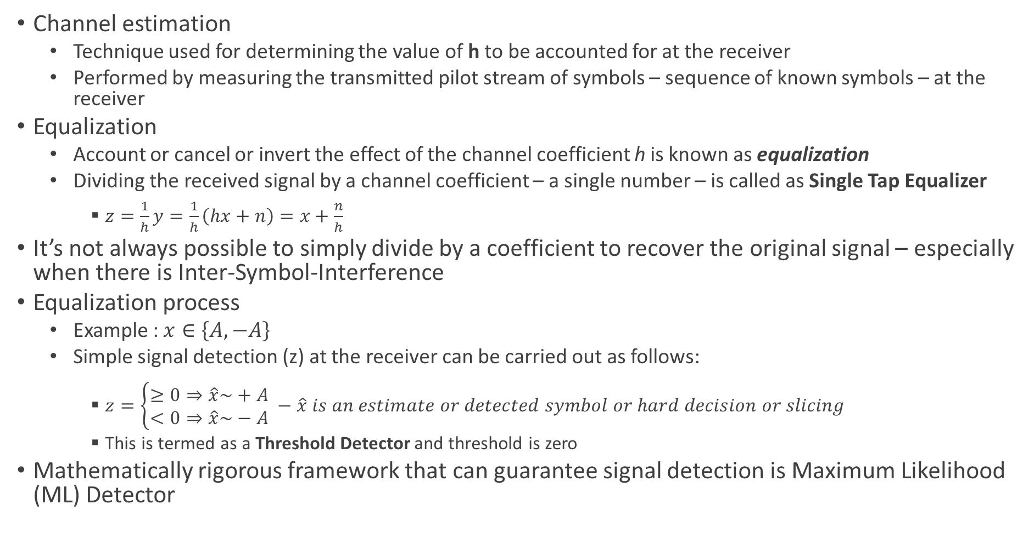
Symbol Detection – Equalization and Estimation
Channel estimation
Technique used for determining the value of h to be accounted for at the receiver
Performed by measuring the transmitted pilot stream of symbols – sequence of known symbols – at the receiver
Equalization
Account or cancel or invert the effect of the channel coefficient h is known as equalization
Dividing the received signal by a channel coefficient – a single number – is called as Single Tap Equalizer
$z=\frac{1}{h}y=\frac{1}{h}\left(hx+n\right)=x+\frac{n}{h}$
It’s not always possible to simply divide by a coefficient to recover the original signal – especially when there is Inter-Symbol-Interference
Equalization process
Example : $x∈\left\{A,−A\right\}$
Simple signal detection (z) at the receiver can be carried out as follows:
$z=\left\{\begin{aligned}≥0⇒\hat{x}\sim +A \\ <0⇒\hat{x}\sim −A\end{aligned}\right. −\hat{x} is an estimate or detected symbol or hard decision or slicing$
This is termed as a Threshold Detector and threshold is zero
Mathematically rigorous framework that can guarantee signal detection is Maximum Likelihood (ML) Detector

Slide 33

Wireless Channel Output SNR
Wireless system $y=hx+n$
The output power of the channel is = ${\left|h\right|}^{2}∗E{\left\{\left|x\right|\right\}}^{2}={\left|h\right|}^{2}∗P=a^{2}P$
a is amplitude and real value whereas h is complex quantity
The channel output SNR, represented as $SNR_{o}$ is
$SNR_{o}=\frac{Signal Power}{Noise Power}=\frac{{\left|h\right|}^{2}P}{\frac{N_{0}}{2}}={\left|h\right|}^{2}∗SNR_{Transmitter}=a^{2}SNR_{Transmitter}$

Slide 34
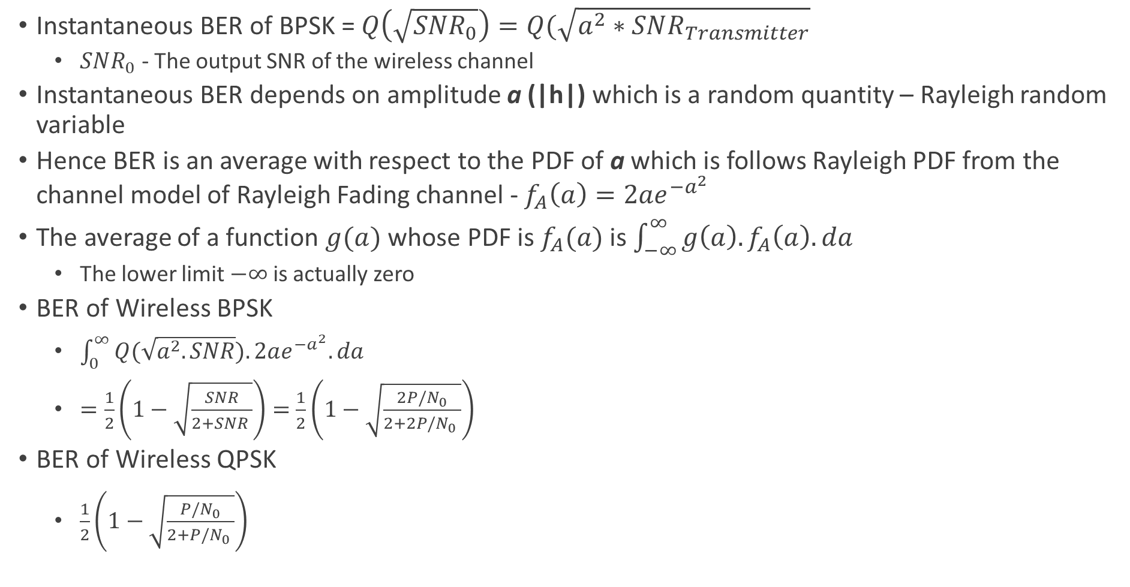
Wireless Channel Performance - BER
Instantaneous BER of BPSK = $Q\left(\sqrt{SNR_{0}}\right)=Q(\sqrt{a^{2}∗SNR_{Transmitter}}$
$SNR_{0}$ - The output SNR of the wireless channel
Instantaneous BER depends on amplitude a (|h|) which is a random quantity – Rayleigh random variable
Hence BER is an average with respect to the PDF of a which is follows Rayleigh PDF from the channel model of Rayleigh Fading channel - $f_{A}\left(a\right)=2ae^{−a^{2}}$
The average of a function $g(a)$ whose PDF is $f_{A}(a)$ is $\int_{−∞}^{∞}{g\left(a\right).f_{A}\left(a\right).da}$
The lower limit $−∞$ is actually zero
BER of Wireless BPSK
$\int_{0}^{∞}{Q(\sqrt{a^{2}.SNR}).2ae^{−a^{2}}.da}$
$=\frac{1}{2}\left(1−\sqrt{\frac{SNR}{2+SNR }}\right)=$ $\frac{1}{2}\left(1−\sqrt{\frac{2P/N_{0}}{2+2P/N_{0} }}\right)$
BER of Wireless QPSK
$\frac{1}{2}\left(1−\sqrt{\frac{P/N_{0}}{2+P/N_{0} }}\right)$

Slide 35
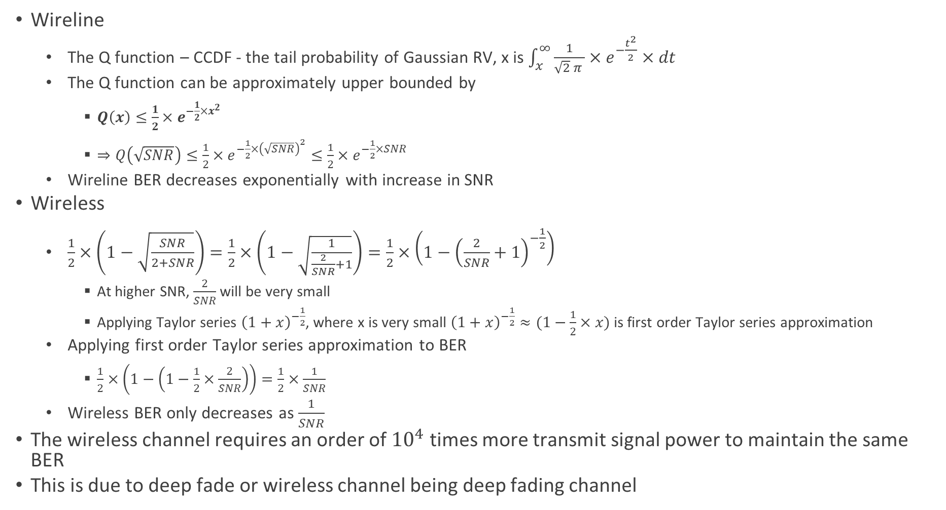
BER of Rayleigh Fading Channel
Wireline
The Q function – CCDF - the tail probability of Gaussian RV, x is $\int_{x}^{∞}{\frac{1}{\sqrt{2} π }×e^{−\frac{t^{2}}{2}}×dt}$
The Q function can be approximately upper bounded by
$Q\left(x\right)≤\frac{1}{2}{×e}^{−\frac{1}{2}×x^{2}}$
$⇒Q\left(\sqrt{SNR}\right)≤\frac{1}{2}×e^{−\frac{1}{2}×{\left(\sqrt{SNR}\right)}^{2}}≤\frac{1}{2}×e^{−\frac{1}{2}×SNR}$
Wireline BER decreases exponentially with increase in SNR
Wireless
$\frac{1}{2}×\left(1−\sqrt{\frac{SNR}{2+SNR}}\right)=\frac{1}{2}×\left(1−\sqrt{\frac{1}{\frac{2}{SNR}+1}}\right)=\frac{1}{2}×\left(1−{\left(\frac{2}{SNR}+1\right)}^{−\frac{1}{2}}\right)$
At higher SNR, $\frac{2}{SNR}$ will be very small
Applying Taylor series ${\left(1+x\right)}^{−\frac{1}{2}}$, where x is very small ${\left(1+x\right)}^{−\frac{1}{2}}≈(1−\frac{1}{2}×x)$ is first order Taylor series approximation
Applying first order Taylor series approximation to BER
$\frac{1}{2}×\left(1−\left(1−\frac{1}{2}×\frac{2}{SNR}\right)\right)=\frac{1}{2}×\frac{1}{SNR}$
Wireless BER only decreases as $\frac{1}{SNR}$
The wireless channel requires an order of ${10}^{4}$ times more transmit signal power to maintain the same BER
This is due to deep fade or wireless channel being deep fading channel

Slide 36
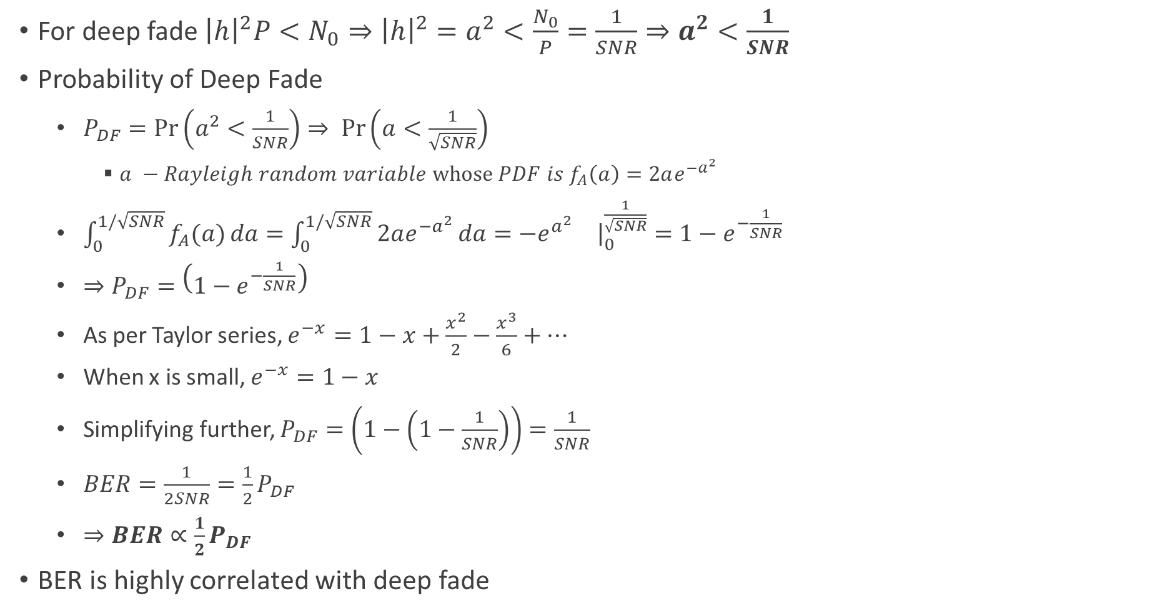
Deep Fade
For deep fade ${\left|h\right|}^{2}P<N_{0}⇒{\left|h\right|}^{2}=a^{2}<\frac{N_{0}}{P}=\frac{1}{SNR}⇒a^{2}<\frac{1}{SNR}$
Probability of Deep Fade
$P_{DF}=\operatorname{Pr}\left(a^{2}<\frac{1}{SNR}\right)⇒ \operatorname{Pr}\left(a<\frac{1}{\sqrt{SNR}}\right)$
$a −Rayleigh random variable whose PDF is f_{A}\left(a\right)=2ae^{−a^{2}}$
$\int_{0}^{1/\sqrt{SNR}}{f_{A}(a)}da=\int_{0}^{1/\sqrt{SNR}}{2ae^{−a^{2}}}da=−e^{a^{2}}{\left.\right|}_{0}^{\frac{1}{\sqrt{SNR}}}=1−e^{−\frac{1}{SNR}}$
$⇒P_{DF}=\left(1−e^{−\frac{1}{SNR}}\right)$
As per Taylor series, $e^{−x}=1−x+\frac{x^{2}}{2}−\frac{x^{3}}{6}+…$
When x is small, $e^{−x}=1−x$
Simplifying further, $P_{DF}=\left(1−\left(1−\frac{1}{SNR}\right)\right)=\frac{1}{SNR}$
$BER=\frac{1}{2SNR}=\frac{1}{2}P_{DF}$
$⇒BER∝\frac{1}{2}P_{DF}$
BER is highly correlated with deep fade

Slide 37
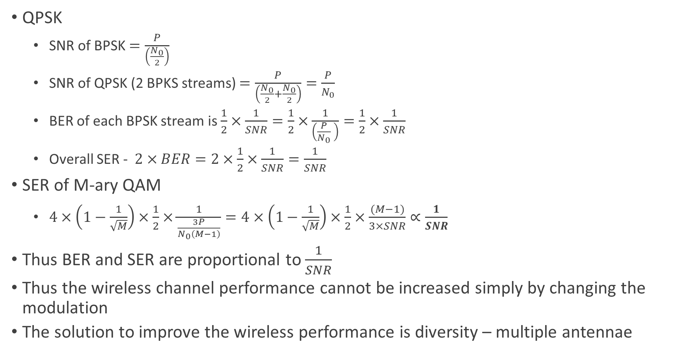
BER and SER of QPSK and QAM
QPSK
SNR of BPSK $=\frac{P}{\left(\frac{N_{0}}{2}\right)}$
SNR of QPSK (2 BPKS streams) $=\frac{P}{\left(\frac{N_{0}}{2}+\frac{N_{0}}{2}\right)}=\frac{P}{N_{0}}$
BER of each BPSK stream is $\frac{1}{2}×\frac{1}{SNR}=\frac{1}{2}×\frac{1}{\left(\frac{P}{N_{0}} \right)}=\frac{1}{2}×\frac{1}{SNR}$
Overall SER - $2×BER=2×\frac{1}{2}×\frac{1}{SNR}=\frac{1}{SNR}$
SER of M-ary QAM
$4×\left(1−\frac{1}{\sqrt{M}}\right)×\frac{1}{2}×\frac{1}{\frac{3P}{N_{0}\left(M−1\right)}}=4×\left(1−\frac{1}{\sqrt{M}}\right)×\frac{1}{2}×\frac{(M−1)}{3×SNR}∝\frac{1}{SNR}$
Thus BER and SER are proportional to $\frac{1}{SNR}$
Thus the wireless channel performance cannot be increased simply by changing the modulation
The solution to improve the wireless performance is diversity – multiple antennae

Slide 38
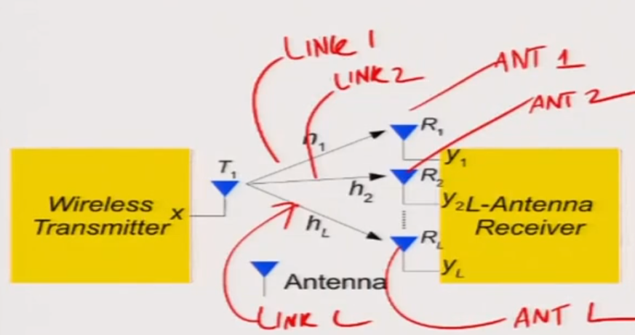
Multiple Antennas and Diversity
Diversity is achieved through multiple links between transmitter and receiver
One simple technique for diversity is to use multiple antennas

Slide 39
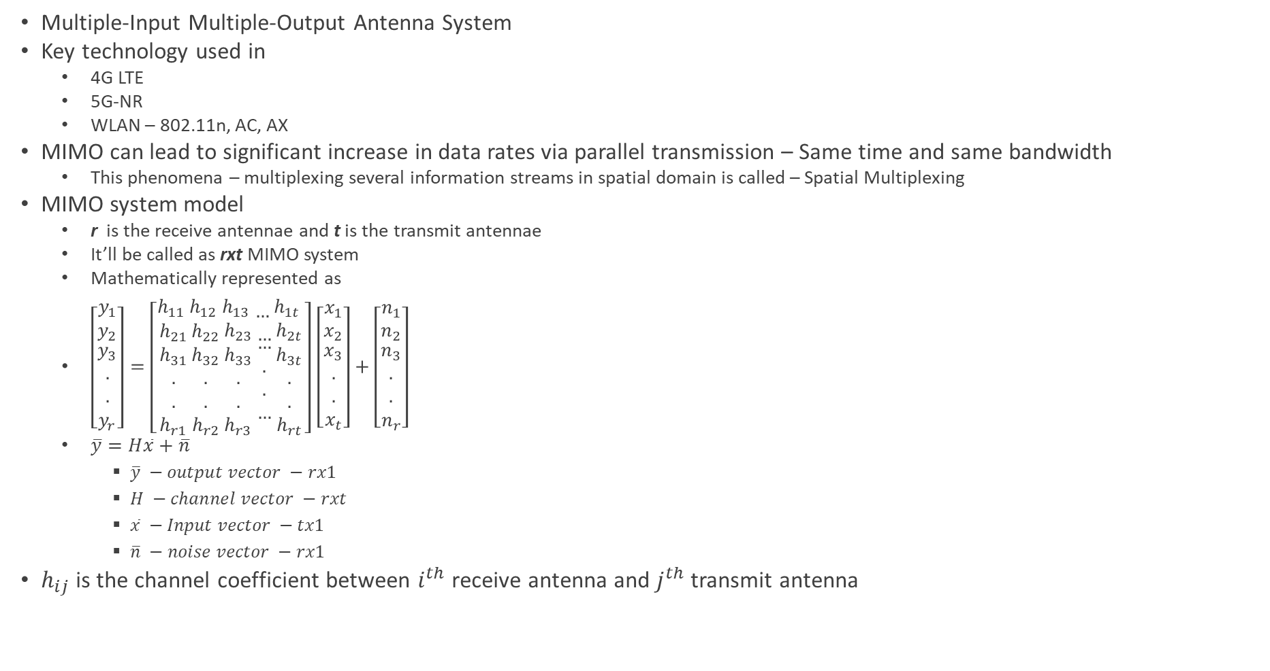
Intro to MIMO System
Multiple-Input Multiple-Output Antenna System
Key technology used in
4G LTE
5G-NR
WLAN – 802.11n, AC, AX
MIMO can lead to significant increase in data rates via parallel transmission – Same time and same bandwidth
This phenomena – multiplexing several information streams in spatial domain is called – Spatial Multiplexing
MIMO system model
r is the receive antennae and t is the transmit antennae
It’ll be called as rxt MIMO system
Mathematically represented as
$\left[\begin{matrix}y_{1} \\ y_{2} \\ \begin{aligned}y_{3} \\ . \\ . \\ y_{r}\end{aligned}\end{matrix}\right]=\left[\begin{matrix}h_{11} \\ h_{21} \\ \begin{aligned}h_{31} \\ . \\ . \\ h_{r1}\end{aligned}\end{matrix}\begin{matrix}h_{12} \\ h_{22} \\ \begin{aligned}h_{32} \\ . \\ . \\ h_{r2}\end{aligned}\end{matrix}\begin{matrix}h_{13} \\ h_{23} \\ \begin{aligned}h_{33} \\ . \\ . \\ h_{r3}\end{aligned}\end{matrix}\begin{matrix}… \\ … \\ \begin{aligned}… \\ . \\ . \\ …\end{aligned}\end{matrix}\begin{matrix}h_{1t} \\ h_{2t} \\ \begin{aligned}h_{3t} \\ . \\ . \\ h_{rt}\end{aligned}\end{matrix}\right]$ $\left[\begin{matrix}x_{1} \\ x_{2} \\ \begin{aligned}x_{3} \\ . \\ . \\ x_{t}\end{aligned}\end{matrix}\right]+\left[\begin{matrix}n_{1} \\ n_{2} \\ \begin{aligned}n_{3} \\ . \\ . \\ n_{r}\end{aligned}\end{matrix}\right]$
$\overline{y}=H\overline{x}+\overline{n}$
$\overline{y} −output vector −rx1$
$H −channel vector −rxt$
$\overline{x} −Input vector −tx1$
$\overline{n} −noise vector −rx1$
$h_{ij}$ is the channel coefficient between $i^{th}$ receive antenna and $j^{th}$ transmit antenna

Slide 40
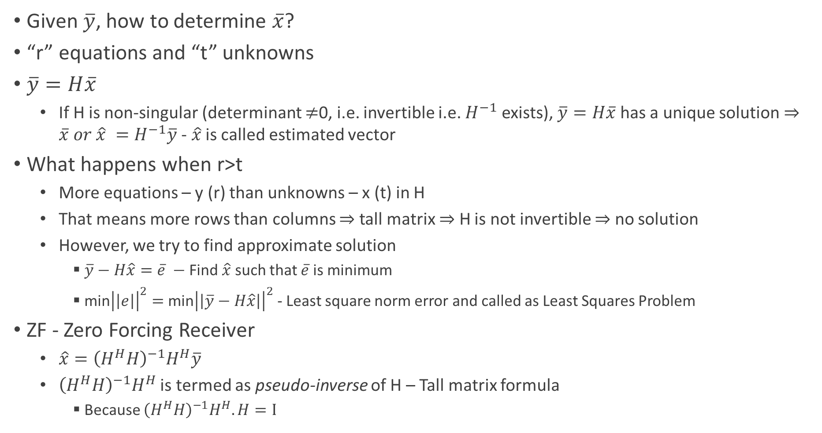
MIMO Receiver
Given $\overline{y}$, how to determine $\overline{x}$?
“r” equations and “t” unknowns
$\overline{y}=H\overline{x}$
If H is non-singular (determinant $≠$0, i.e. invertible i.e. $H^{−1}$ exists), $\overline{y}=H\overline{x}$ has a unique solution $⇒\overline{x} or \hat{x} =H^{−1}\overline{y}$ - $\hat{x}$ is called estimated vector
What happens when r>t
More equations – y (r) than unknowns – x (t) in H
That means more rows than columns $⇒$ tall matrix $⇒$ H is not invertible $⇒$ no solution
However, we try to find approximate solution
$\overline{y}−H\hat{x}=\overline{e} −$Find $\hat{x}$ such that $\overline{e}$ is minimum
min${\left|\left|e\right|\right|}^{2}=$ min${\left|\left|\overline{y}−H\hat{x}\right|\right|}^{2}$ - Least square norm error and called as Least Squares Problem
ZF - Zero Forcing Receiver
$\hat{x}={\left(H^{H}H\right)}^{−1}H^{H}\overline{y}$
${\left(H^{H}H\right)}^{−1}H^{H}$ is termed as pseudo-inverse of H – Tall matrix formula
Because ${\left(H^{H}H\right)}^{−1}H^{H}.H=I$

Slide 41
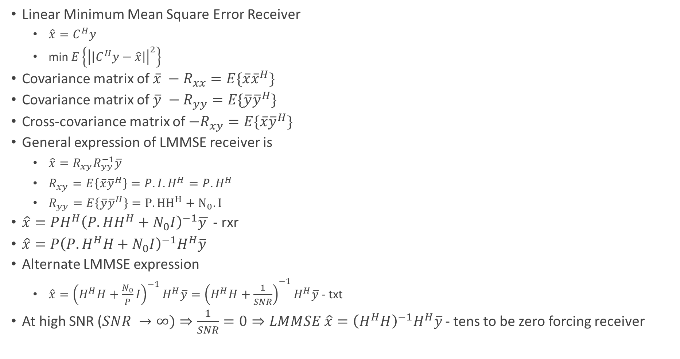
MIMO LMMSE Receiver
Linear Minimum Mean Square Error Receiver
${\hat{x}=C}^{H}y$
min$E\left\{{\left|\left|C^{H}y−\hat{x}\right|\right|}^{2}\right\}$
Covariance matrix of $\overline{x} −R_{xx}=E\{\overline{x}{\overline{x}}^{H}\}$
Covariance matrix of $\overline{y} −R_{yy}=E\{\overline{y}{\overline{y}}^{H}\}$
Cross-covariance matrix of $−R_{xy}=E\{\overline{x}{\overline{y}}^{H}\}$
General expression of LMMSE receiver is
$\hat{x}=R_{xy}R_{yy}^{−1}\overline{y}$
$R_{xy}=E\left\{\overline{x}{\overline{y}}^{H}\right\}=P.I.H^{H}=P.H^{H}$
$R_{yy}=E\left\{\overline{y}{\overline{y}}^{H}\right\}=P.{HH}^{H}+N_{0}.I$
$\hat{x}=PH^{H}{\left(P.HH^{H}+N_{0}I\right)}^{−1}\overline{y }$ - rxr
$\hat{x}=P{\left(P.H^{H}H+N_{0}I\right)}^{−1}H^{H}\overline{y}$
Alternate LMMSE expression
$\hat{x}={{\left(H^{H}H+\frac{N_{0}}{P}I\right)}^{−1}H^{H}\overline{y}=\left(H^{H}H+\frac{1}{SNR}\right)}^{−1}H^{H}\overline{y}$ - txt
At high SNR ($SNR →∞)⇒\frac{1}{SNR}=0⇒LMMSE \hat{x}={\left(H^{H}H\right)}^{−1}H^{H}\overline{y}$ - tens to be zero forcing receiver

Slide 42
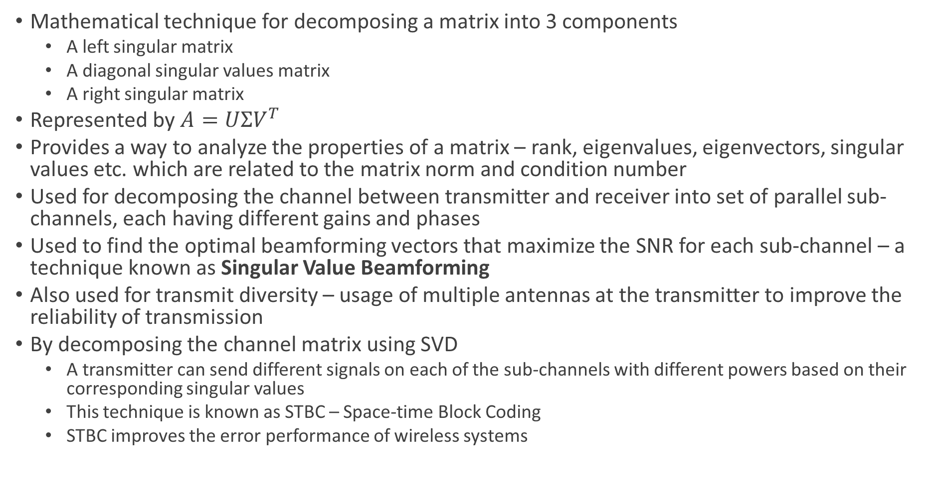
SVD – Singular Value Decomposition
Mathematical technique for decomposing a matrix into 3 components
A left singular matrix
A diagonal singular values matrix
A right singular matrix
Represented by $A=UΣV^{T}$
Provides a way to analyze the properties of a matrix – rank, eigenvalues, eigenvectors, singular values etc. which are related to the matrix norm and condition number
Used for decomposing the channel between transmitter and receiver into set of parallel sub-channels, each having different gains and phases
Used to find the optimal beamforming vectors that maximize the SNR for each sub-channel – a technique known as Singular Value Beamforming
Also used for transmit diversity – usage of multiple antennas at the transmitter to improve the reliability of transmission
By decomposing the channel matrix using SVD
A transmitter can send different signals on each of the sub-channels with different powers based on their corresponding singular values
This technique is known as STBC – Space-time Block Coding
STBC improves the error performance of wireless systems

Slide 43
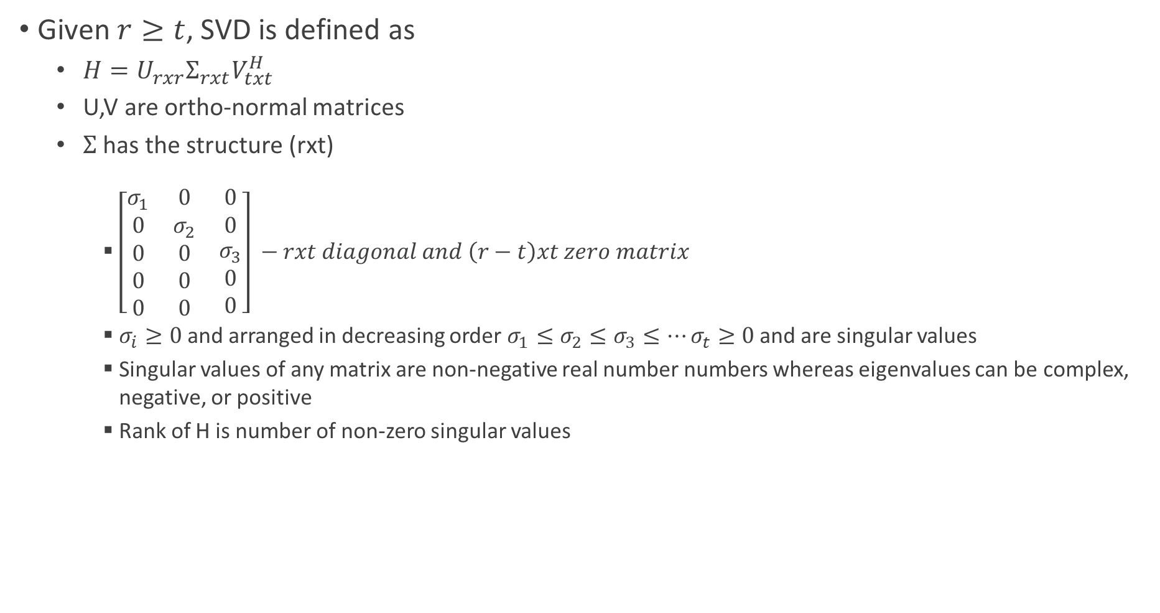
SVD
Given $r≥t$, SVD is defined as
$H=U_{rxr}Σ_{rxt}V_{txt}^{H}$
U,V are ortho-normal matrices
$Σ$ has the structure (rxt)
$\left[\begin{matrix}σ_{1} & 0 & 0 \\ 0 & σ_{2} & 0 \\ \begin{aligned}0 \\ 0 \\ 0\end{aligned} & \begin{aligned}0 \\ 0 \\ 0\end{aligned} & \begin{aligned}σ_{3} \\ 0 \\ 0\end{aligned}\end{matrix}\right] −rxt diagonal and \left(r−t\right)xt zero matrix$
$σ_{i}≥0$ and arranged in decreasing order $σ_{1}≤σ_{2}≤σ_{3}≤…σ_{t}≥0$ and are singular values
Singular values of any matrix are non-negative real number numbers whereas eigenvalues can be complex, negative, or positive
Rank of H is number of non-zero singular values

Slide 44

SVD Relation to Eigenvalue Decomposition
$H^{H}H=V\left[\begin{matrix}σ_{1}^{2} & ⋯ & 0 \\ ⋮ & ⋱ & ⋮ \\ 0 & ⋯ & σ_{t}^{2}\end{matrix}\right]$
$σ_{1}^{2}, σ_{2}^{2}, σ_{3}^{2}…σ_{t}^{2}$ are non-zero eigenvalues of $H^{H}H$
V contains eigen vectors $v_{1}, v_{2},v_{3},…v_{t}$ of $H^{H}H$
$σ_{1}^{2}, σ_{2}^{2}, σ_{3}^{2}…σ_{t}^{2}$ are non-zero eigenvalues of $HH^{H}$
U contains eigen vectors $u_{1}, u_{2},u_{3},…{u }_{t}$ of $HH^{H}$

Slide 45
SVD Processing

Slide 46
Capacity of MIMO Wireless Systems

Slide 47
Alamouti Code
The main idea behind Alamouti coding is to transmit the same data over multiple antennas in a way that maximizes diversity
If one of the antennas experiences fading or interference, the data can still be recovered from the other antenna
This is achieved by transmitting the data in a space-time block code, where the data is transmitted over multiple time slots and multiple antennas improving the reliability and capacity of transmission
Particularly useful when the transmitted signal is subjected to fading due to multipath propagation
It is a 2x1 Orthogonal STBC – used for 2 transmit antennae and 1 receive antenna system (a 1x2 (rxt) diverse system – MISO system)
It encodes two complex symbols onto two transmit antennae and transmits over two consecutive time slots providing diversity and improved SNR at the receiver
In the first time slot, the two complex symbols are transmitted on the two antennas
In the second time slot, the same two symbols are transmitted again, but with the conjugate of one symbol transmitted on the second antenna

Slide 48
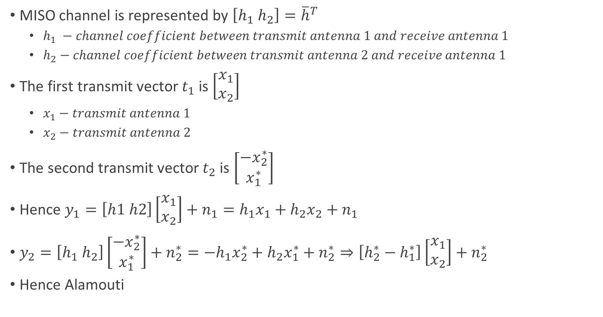
Alamouti
MISO channel is represented by $\left[h_{1} h_{2}\right]={\overline{h}}^{T}$
$h_{1} −channel coefficient between transmit antenna 1 and receive antenna 1$
$h_{2}−channel coefficient between transmit antenna 2 and receive antenna 1$
The first transmit vector $t_{1}$ is $\left[\begin{aligned}x_{1} \\ x_{2}\end{aligned}\right]$
$x_{1}−transmit antenna 1$
$x_{2}−transmit antenna 2$
The second transmit vector $t_{2}$ is $\left[\begin{aligned}{−x}_{2}^{∗} \\ x_{1}^{∗}\end{aligned}\right]$
Hence $y_{1}=\left[h1 h2\right]\left[\begin{aligned}x_{1} \\ x_{2}\end{aligned}\right]+n_{1}=h_{1}x_{1}+h_{2}x_{2}+n_{1}$
$y_{2}=\left[h_{1} h_{2}\right]\left[\begin{aligned}{−x}_{2}^{∗} \\ x_{1}^{∗}\end{aligned}\right]+n_{2}^{∗}=−h_{1}x_{2}^{∗}+h_{2}x_{1}^{∗}+n_{2}^{∗}⇒\left[h_{2}^{∗}−h_{1}^{∗}\right]\left[\begin{aligned}x_{1} \\ x_{2}\end{aligned}\right]+n_{2}^{∗}$
Hence Alamouti

Slide 49
BER of Alamouti Code

Slide 50
Multi-carrier Modulation

Slide 51
OFDM

Slide 52
OFDM System Model

Slide 53
OFDM Examples

Slide 54
BER Performance of OFDM Systems

Slide 55
MIMO-OFDM

Slide 56
Delay Spread
An important characteristic of a multi-path channel is the time delay spread it causes to the received signal
This delay spread equals the time delay between
The arrival of the first received signal component (LOS or multi-path)
Last received signal component associated with a single transmitted pulse
If the delay spread is
Small compared to the inverse of the signal bandwidth, then there is little time spreading in the received signal
Relatively large compared to the inverse of the signal bandwidth, then there is significant time spreading of the received signal which leads to substantial signal distortion

Slide 57
ISI Channel Model

Slide 58
Doppler Shift

